Slide 1
Plantish
Gardener’s Marketplace
Ruby On Rails
Developed by Syeda Ismat Farjana

Slide 2
What is Plantish
A two-way marketplace app for selling and buying Garden products
The category range is -
Fruits
Vegetables
Flowers
Seeds
Seedlings
Small plants
Indoor plants
Terrariums
Succulents
Garden Tools
Household compost
Mulching
Helping hands

Slide 3
What problem is being solved?
Lack of garden fresh products
Helping hands for gardening
Expensive garden tools
Local compost
Source of income
Small business opportunity
Work from home opportunity

Slide 4
Why Plantish?
Plantish makes a scope for passionate gardeners to sell their freshly grown garden products, selling or renting garden tools, helping each other with by sharing their gardening skills.

Slide 5
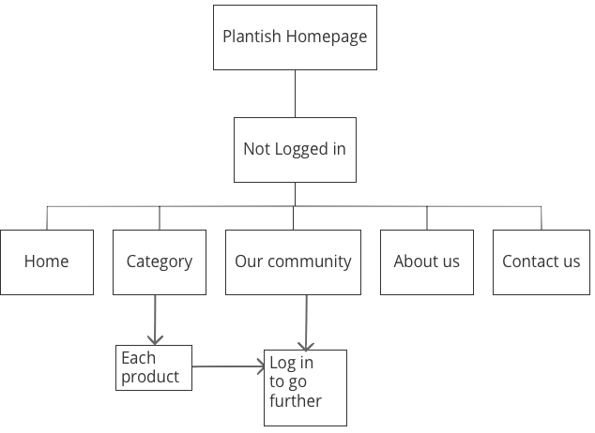
Site map (not logged in)

Slide 6
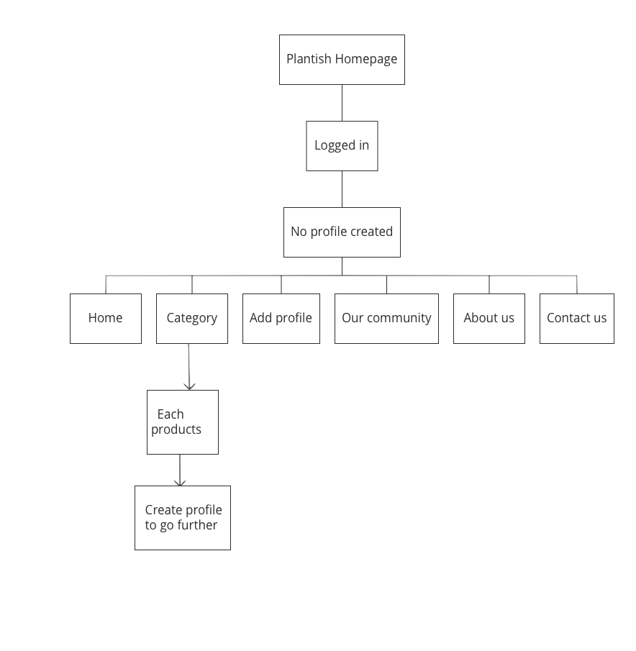
Site map (logged in but no profile)

Slide 7
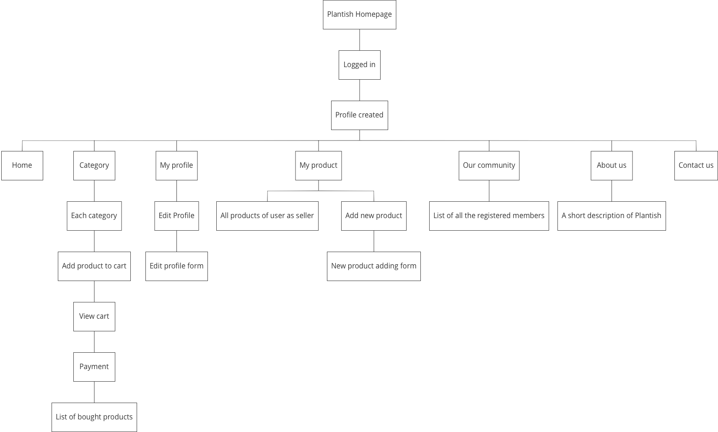
Site map (logged in & profile present)

Slide 8

Let’s have a walk
Plantish : Heroku Deployment
Screenshots of pages coming next...

Slide 9
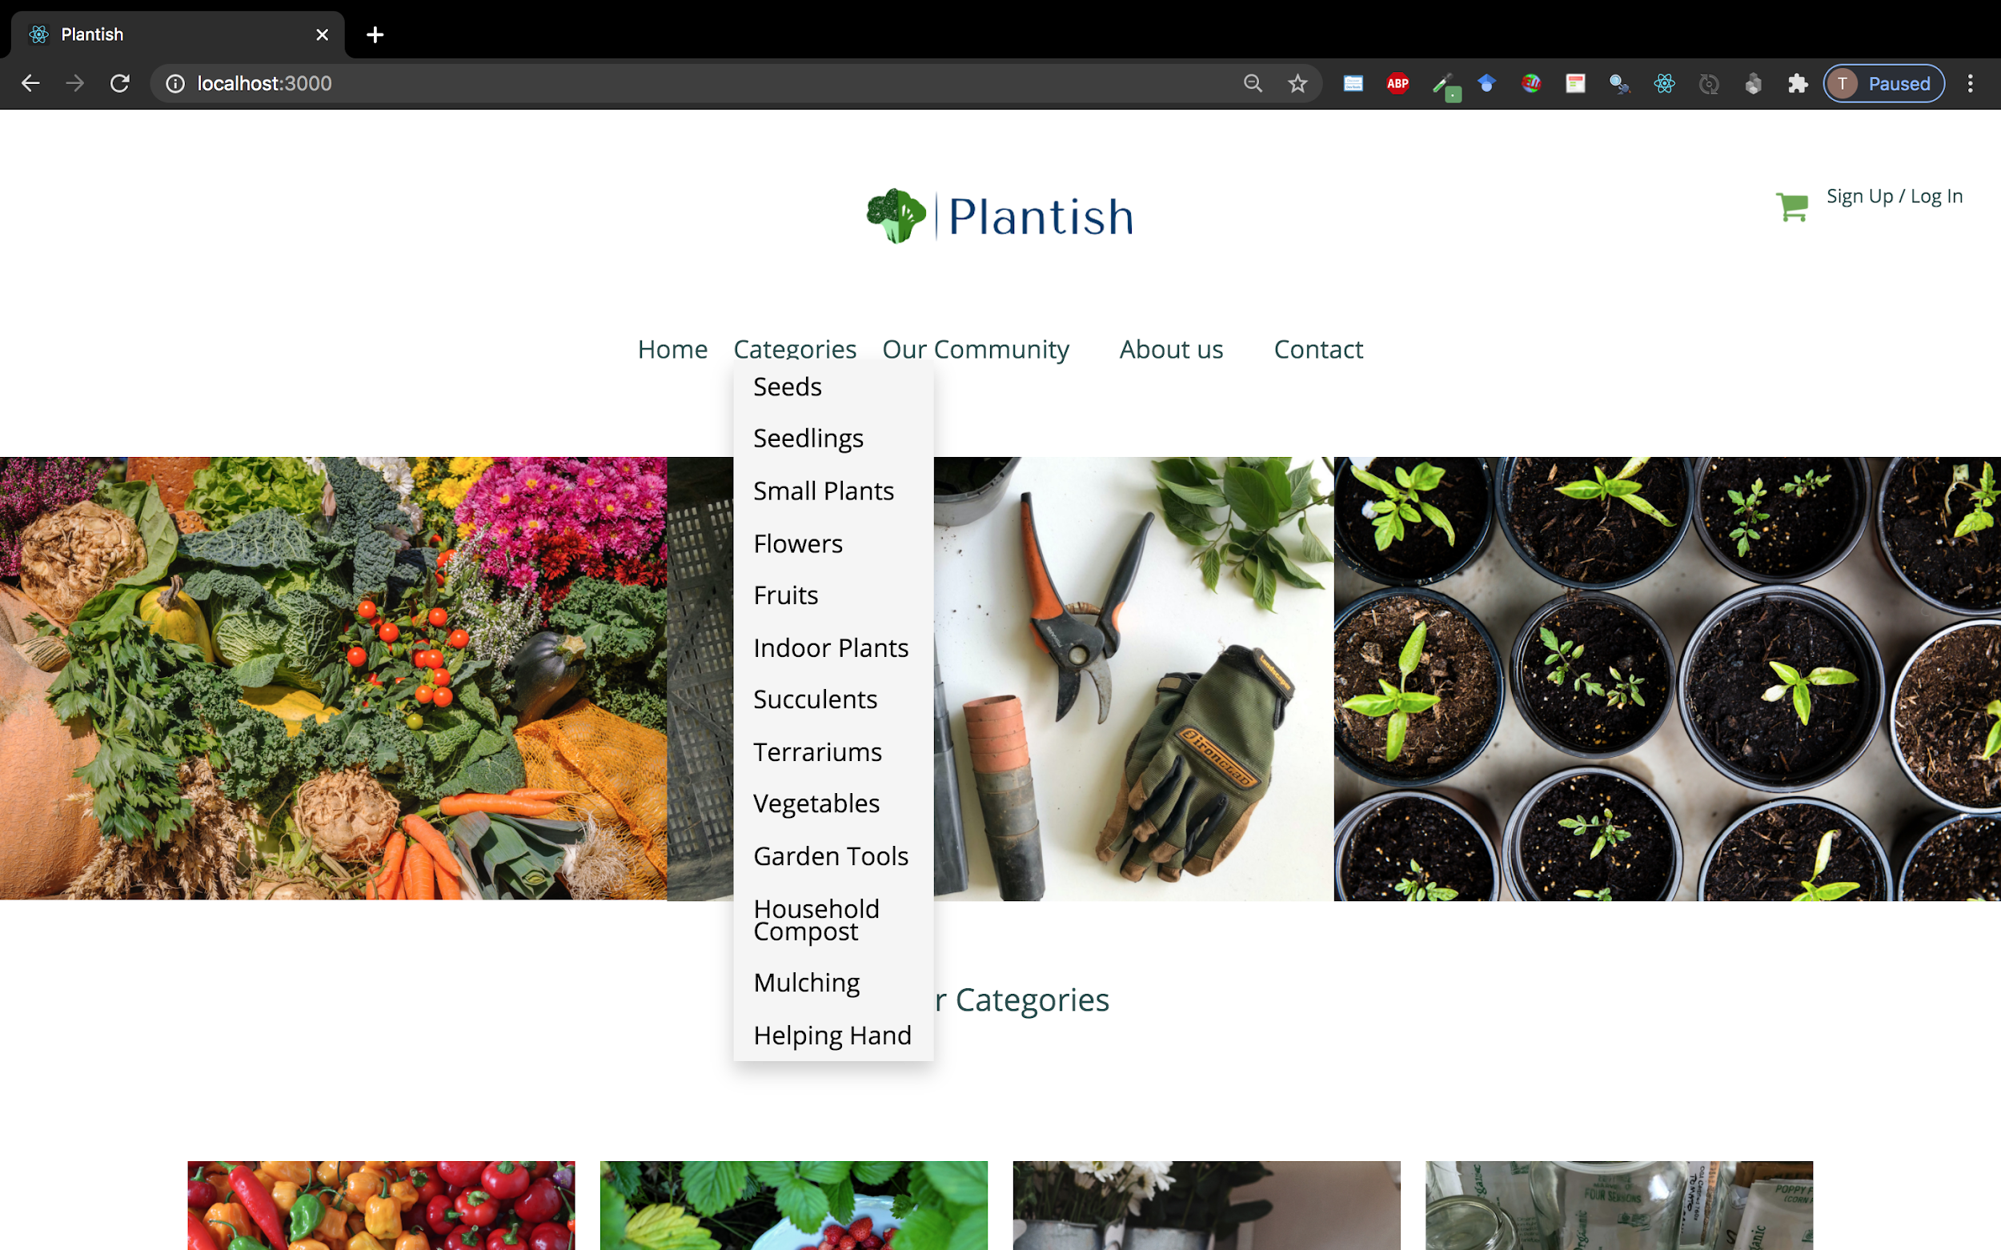

Slide 10
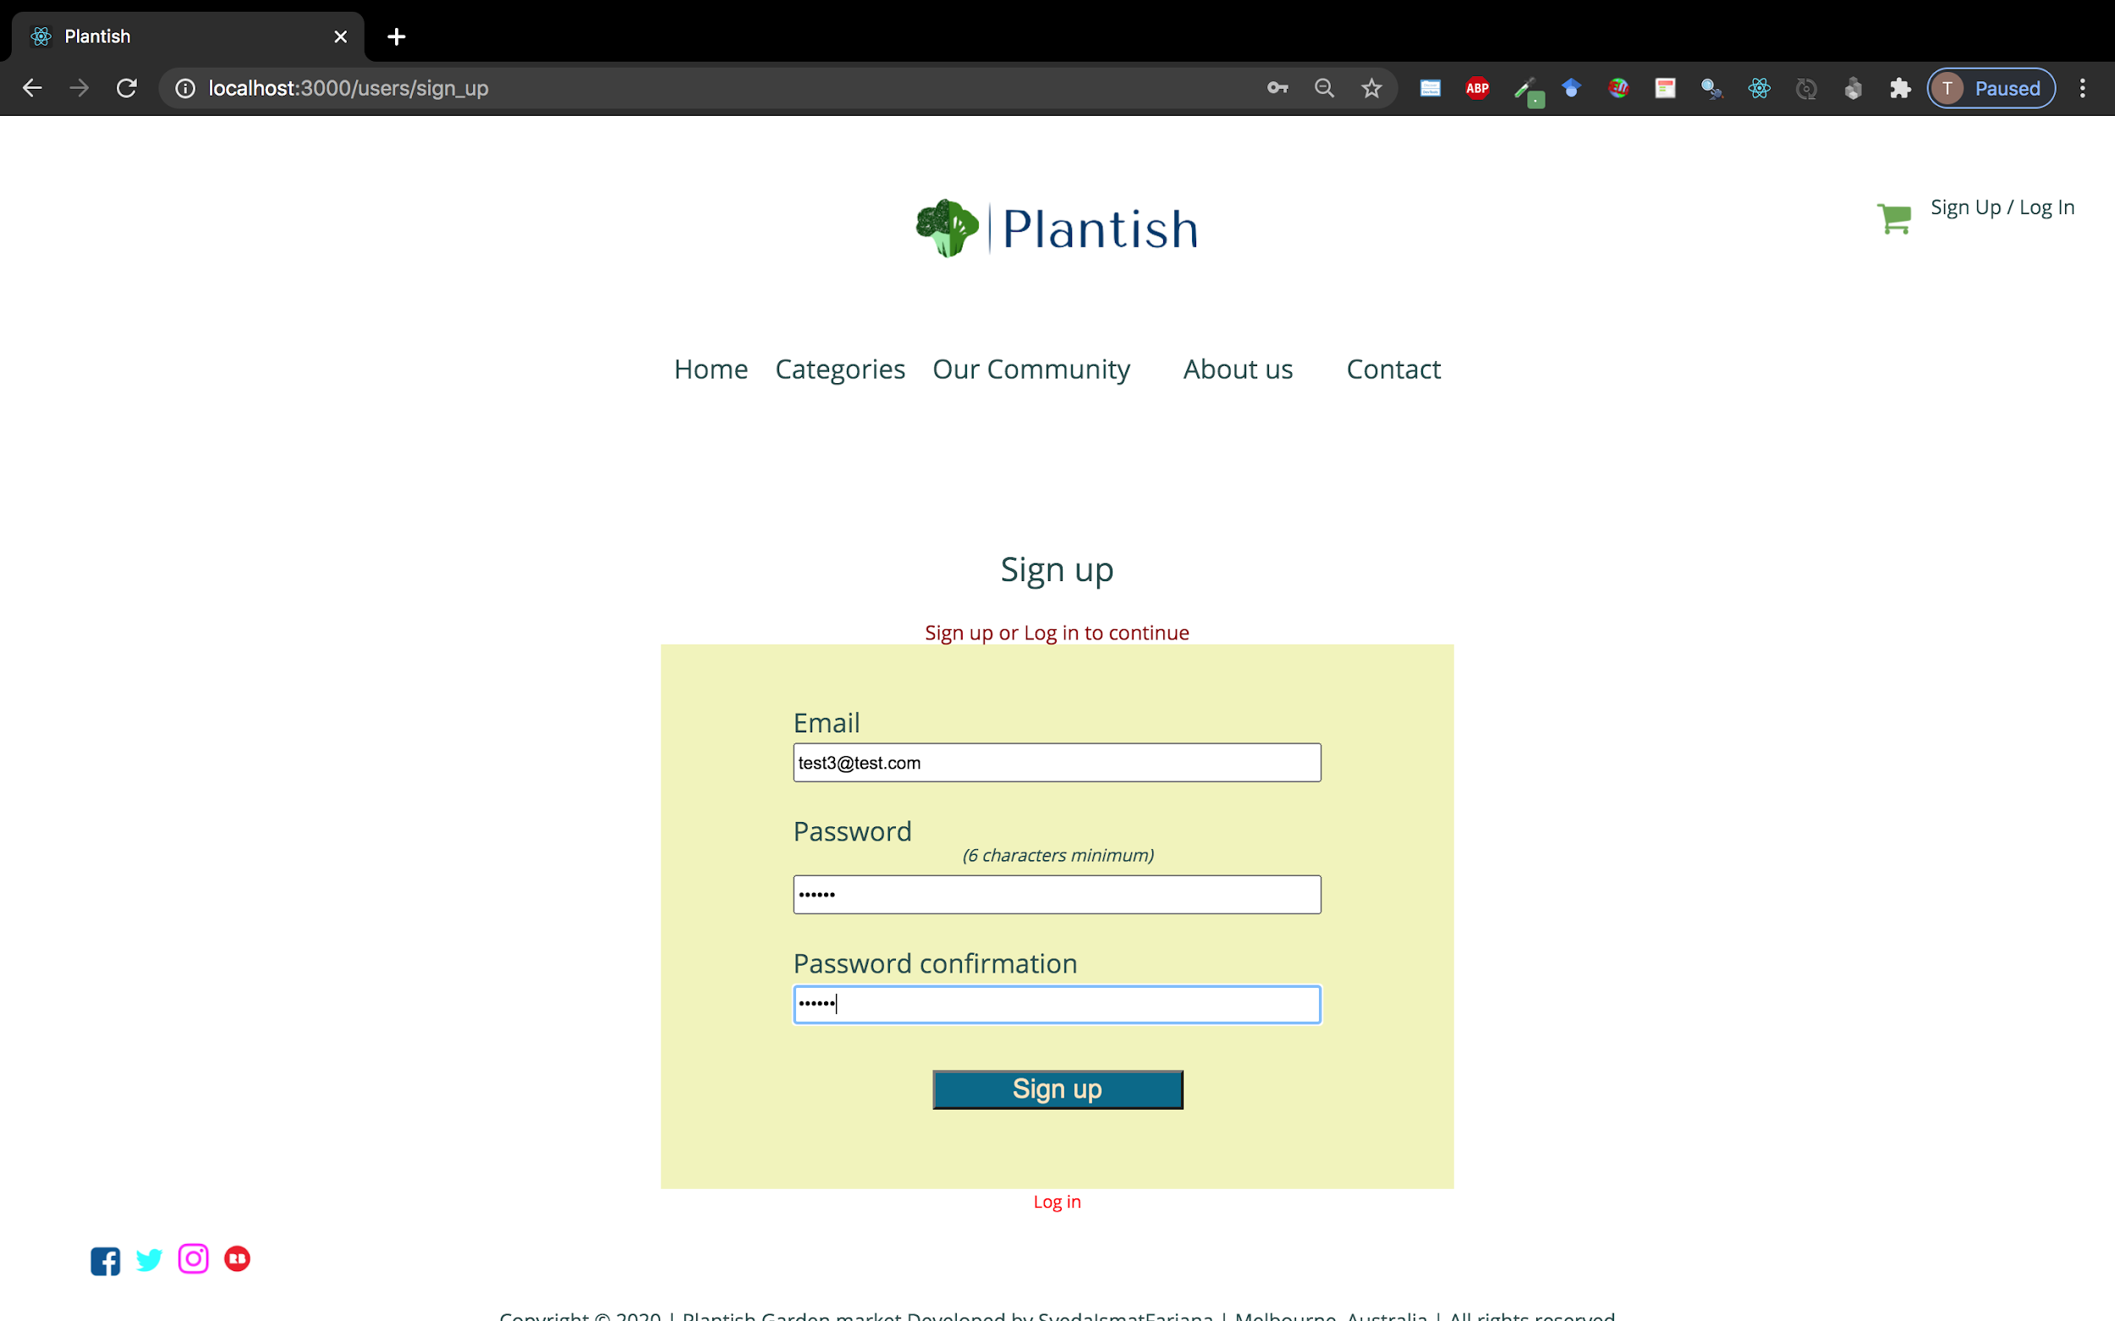

Slide 11
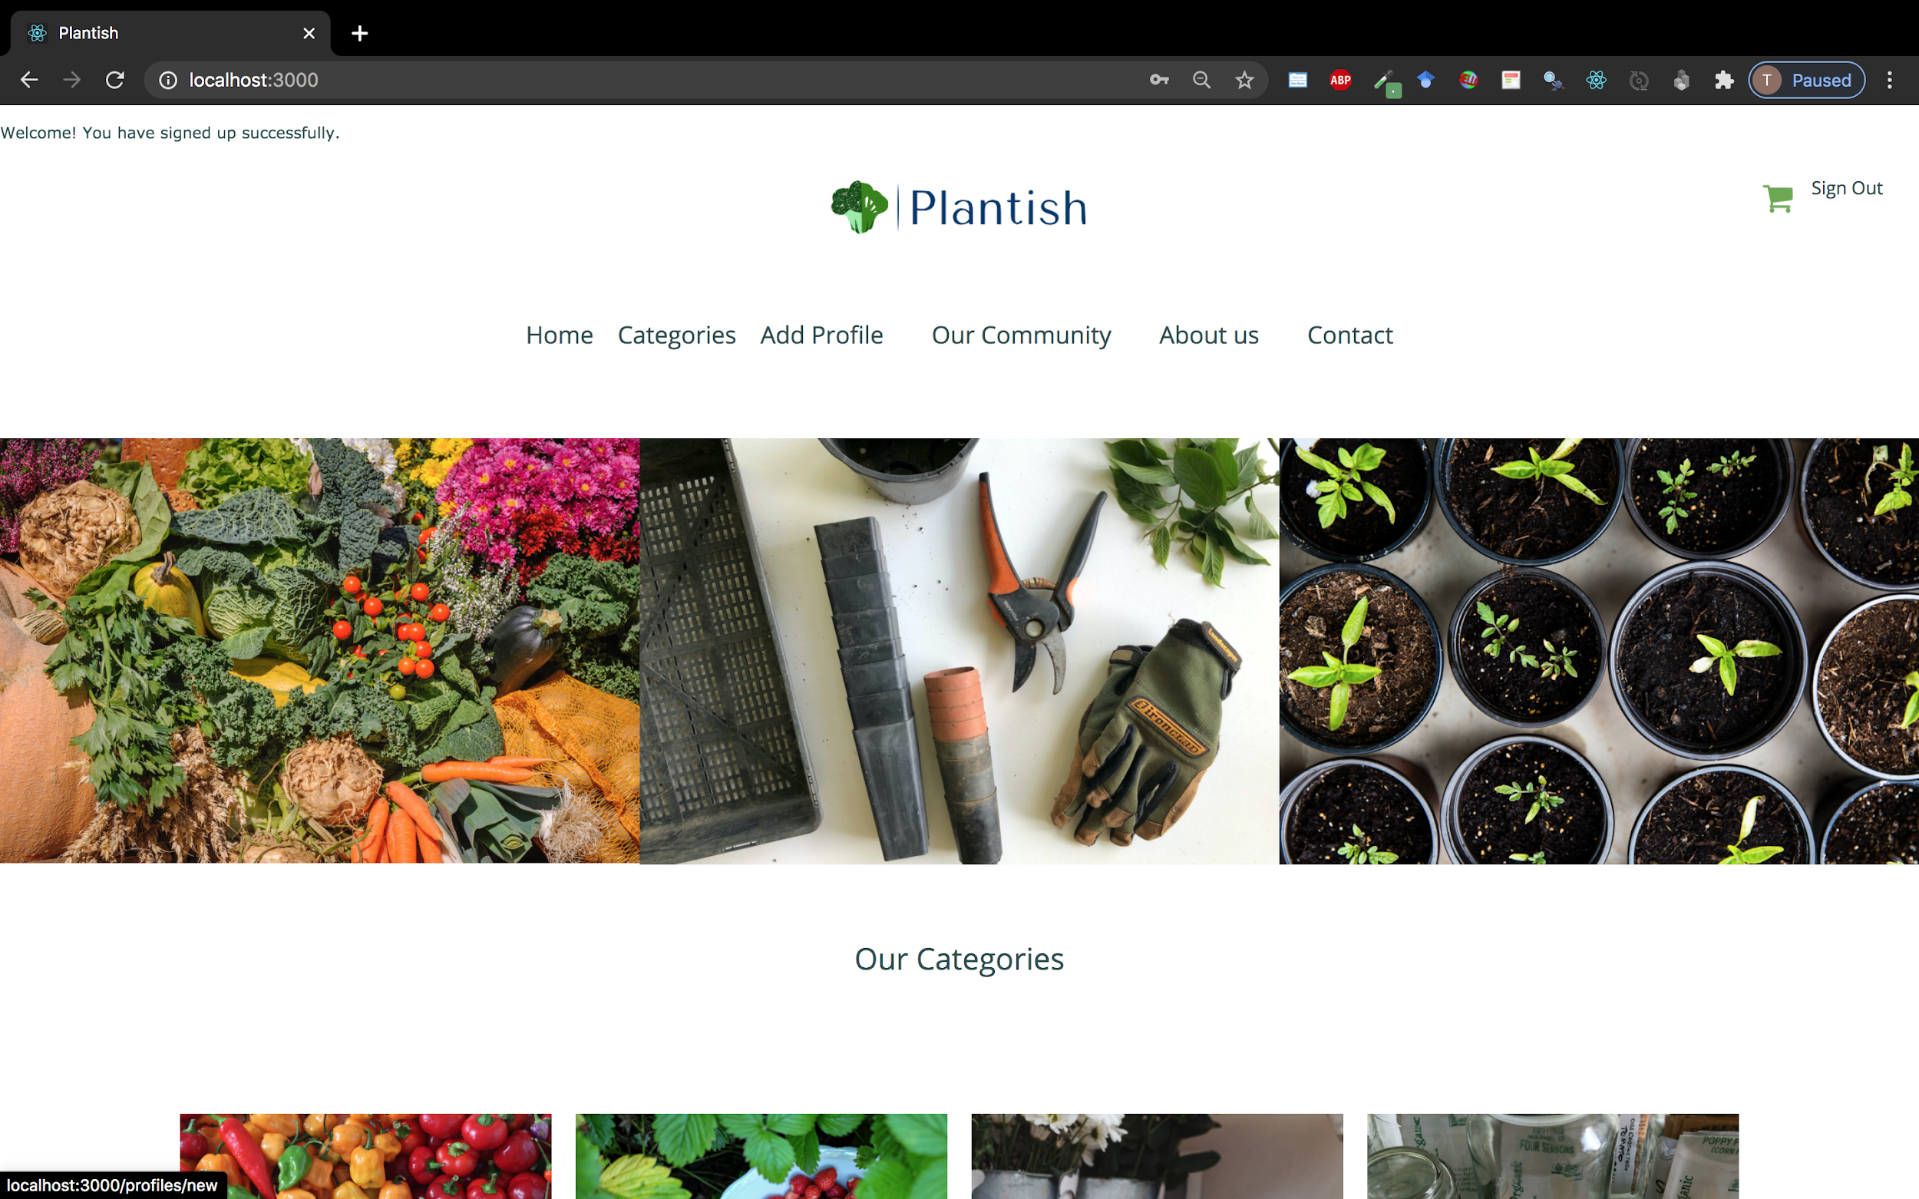

Slide 12
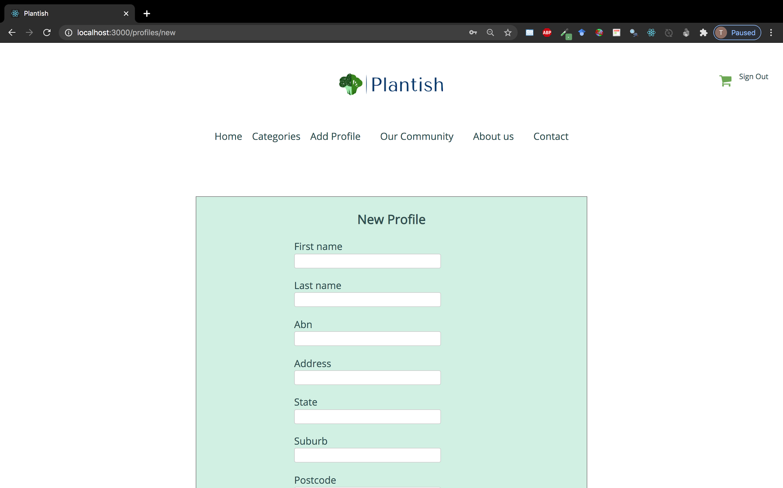

Slide 13
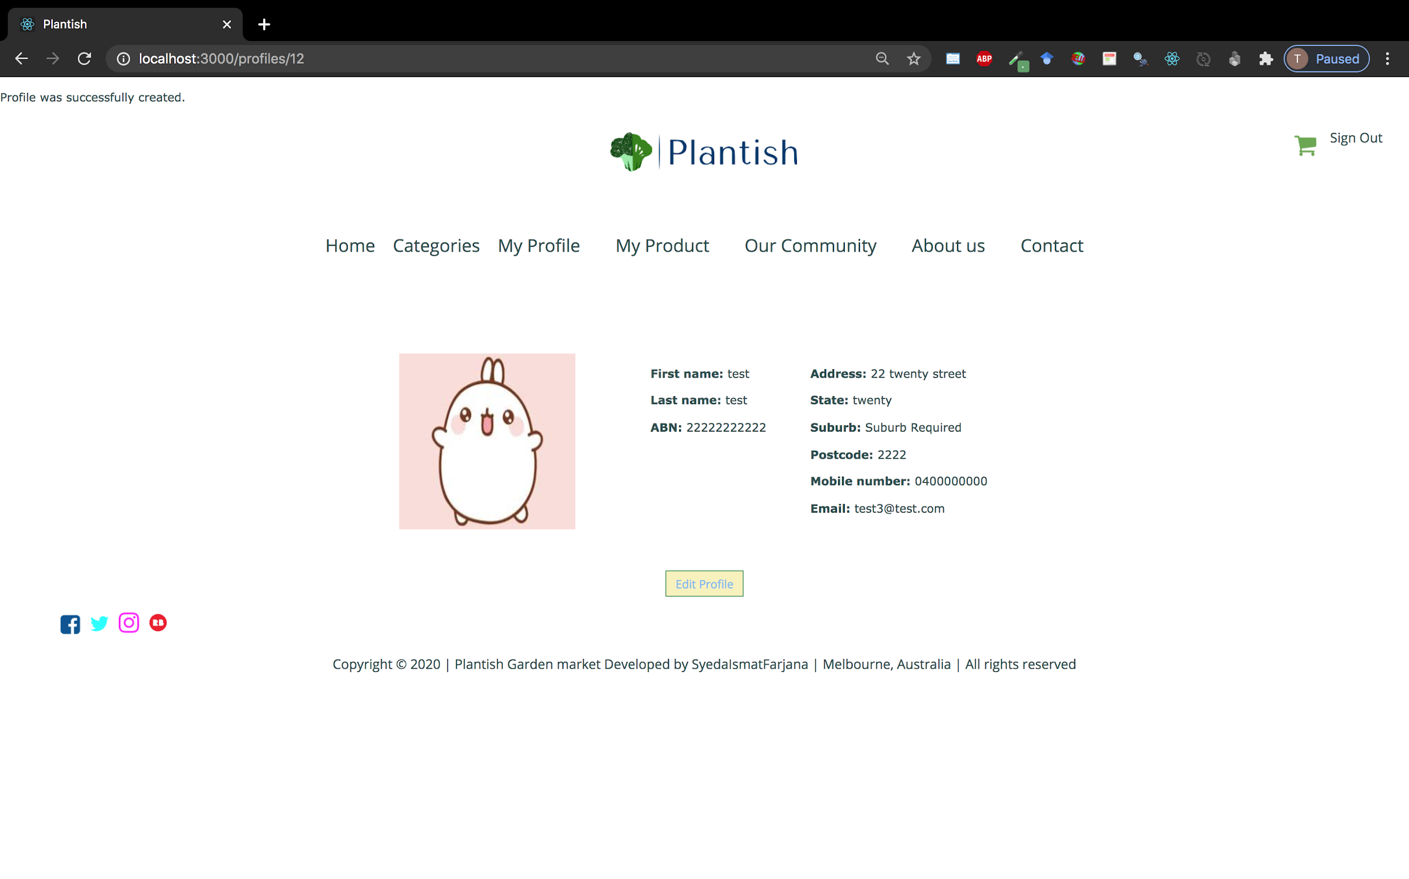

Slide 14
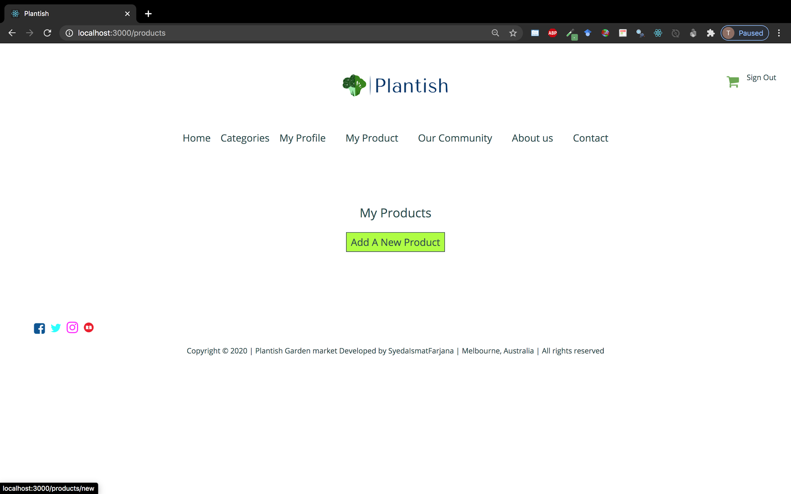

Slide 15
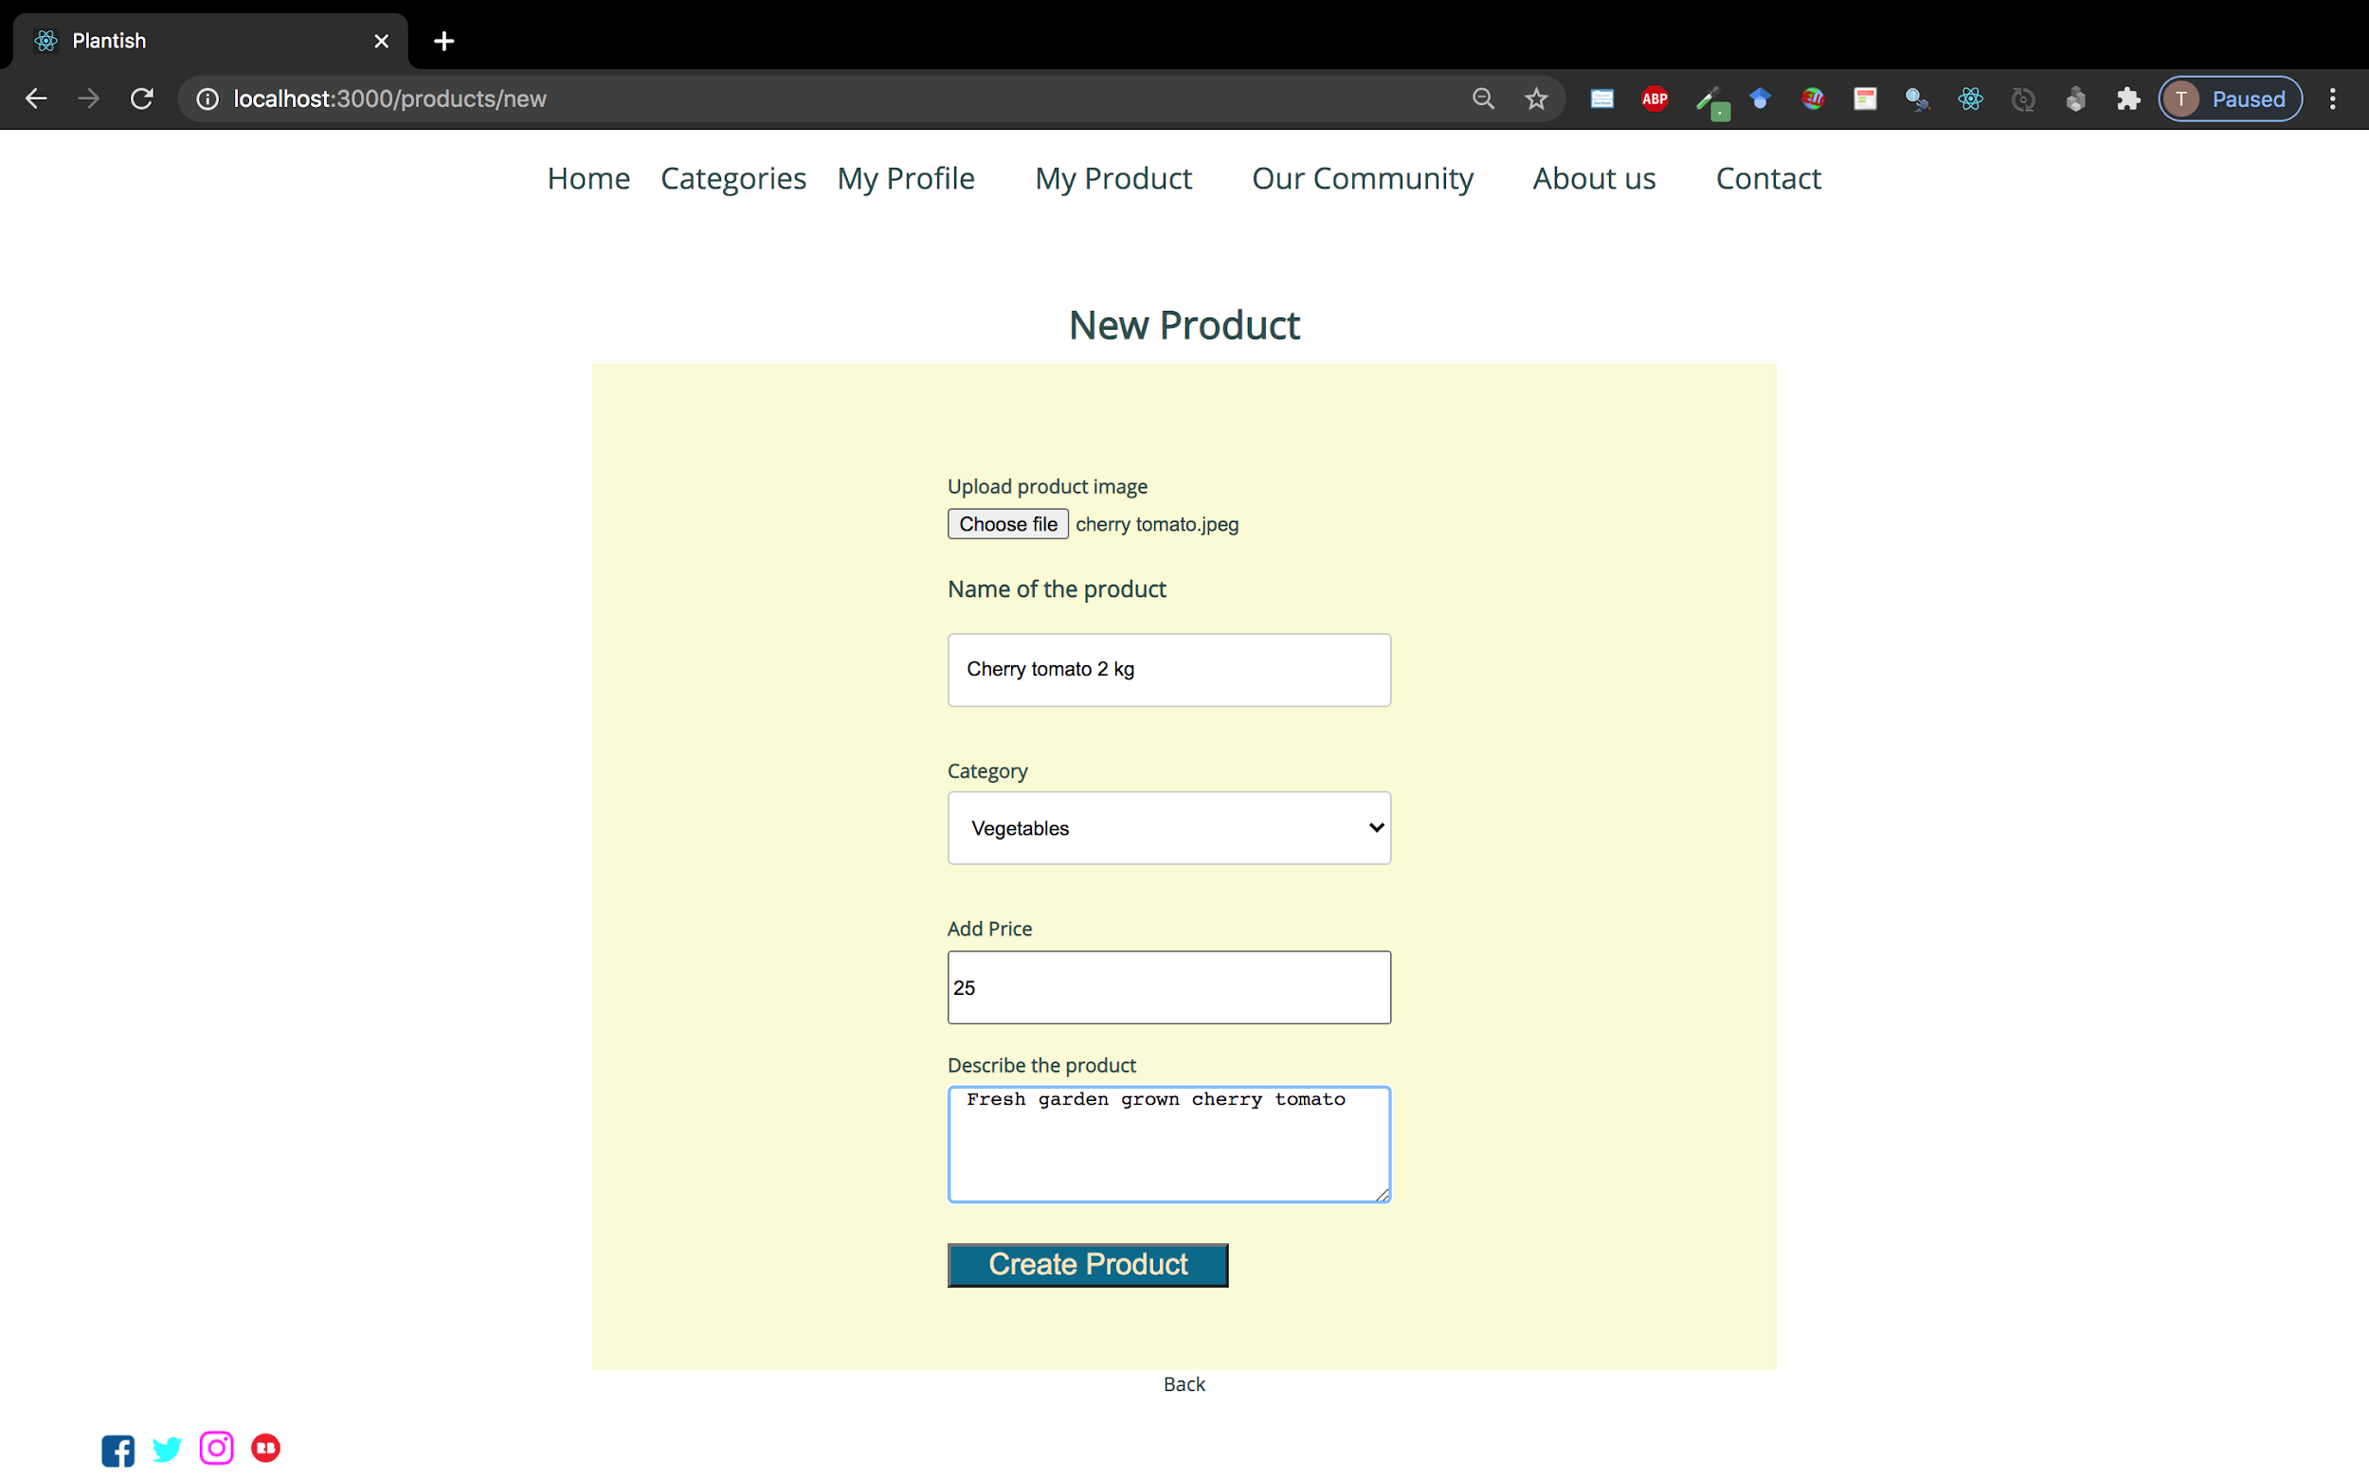

Slide 16
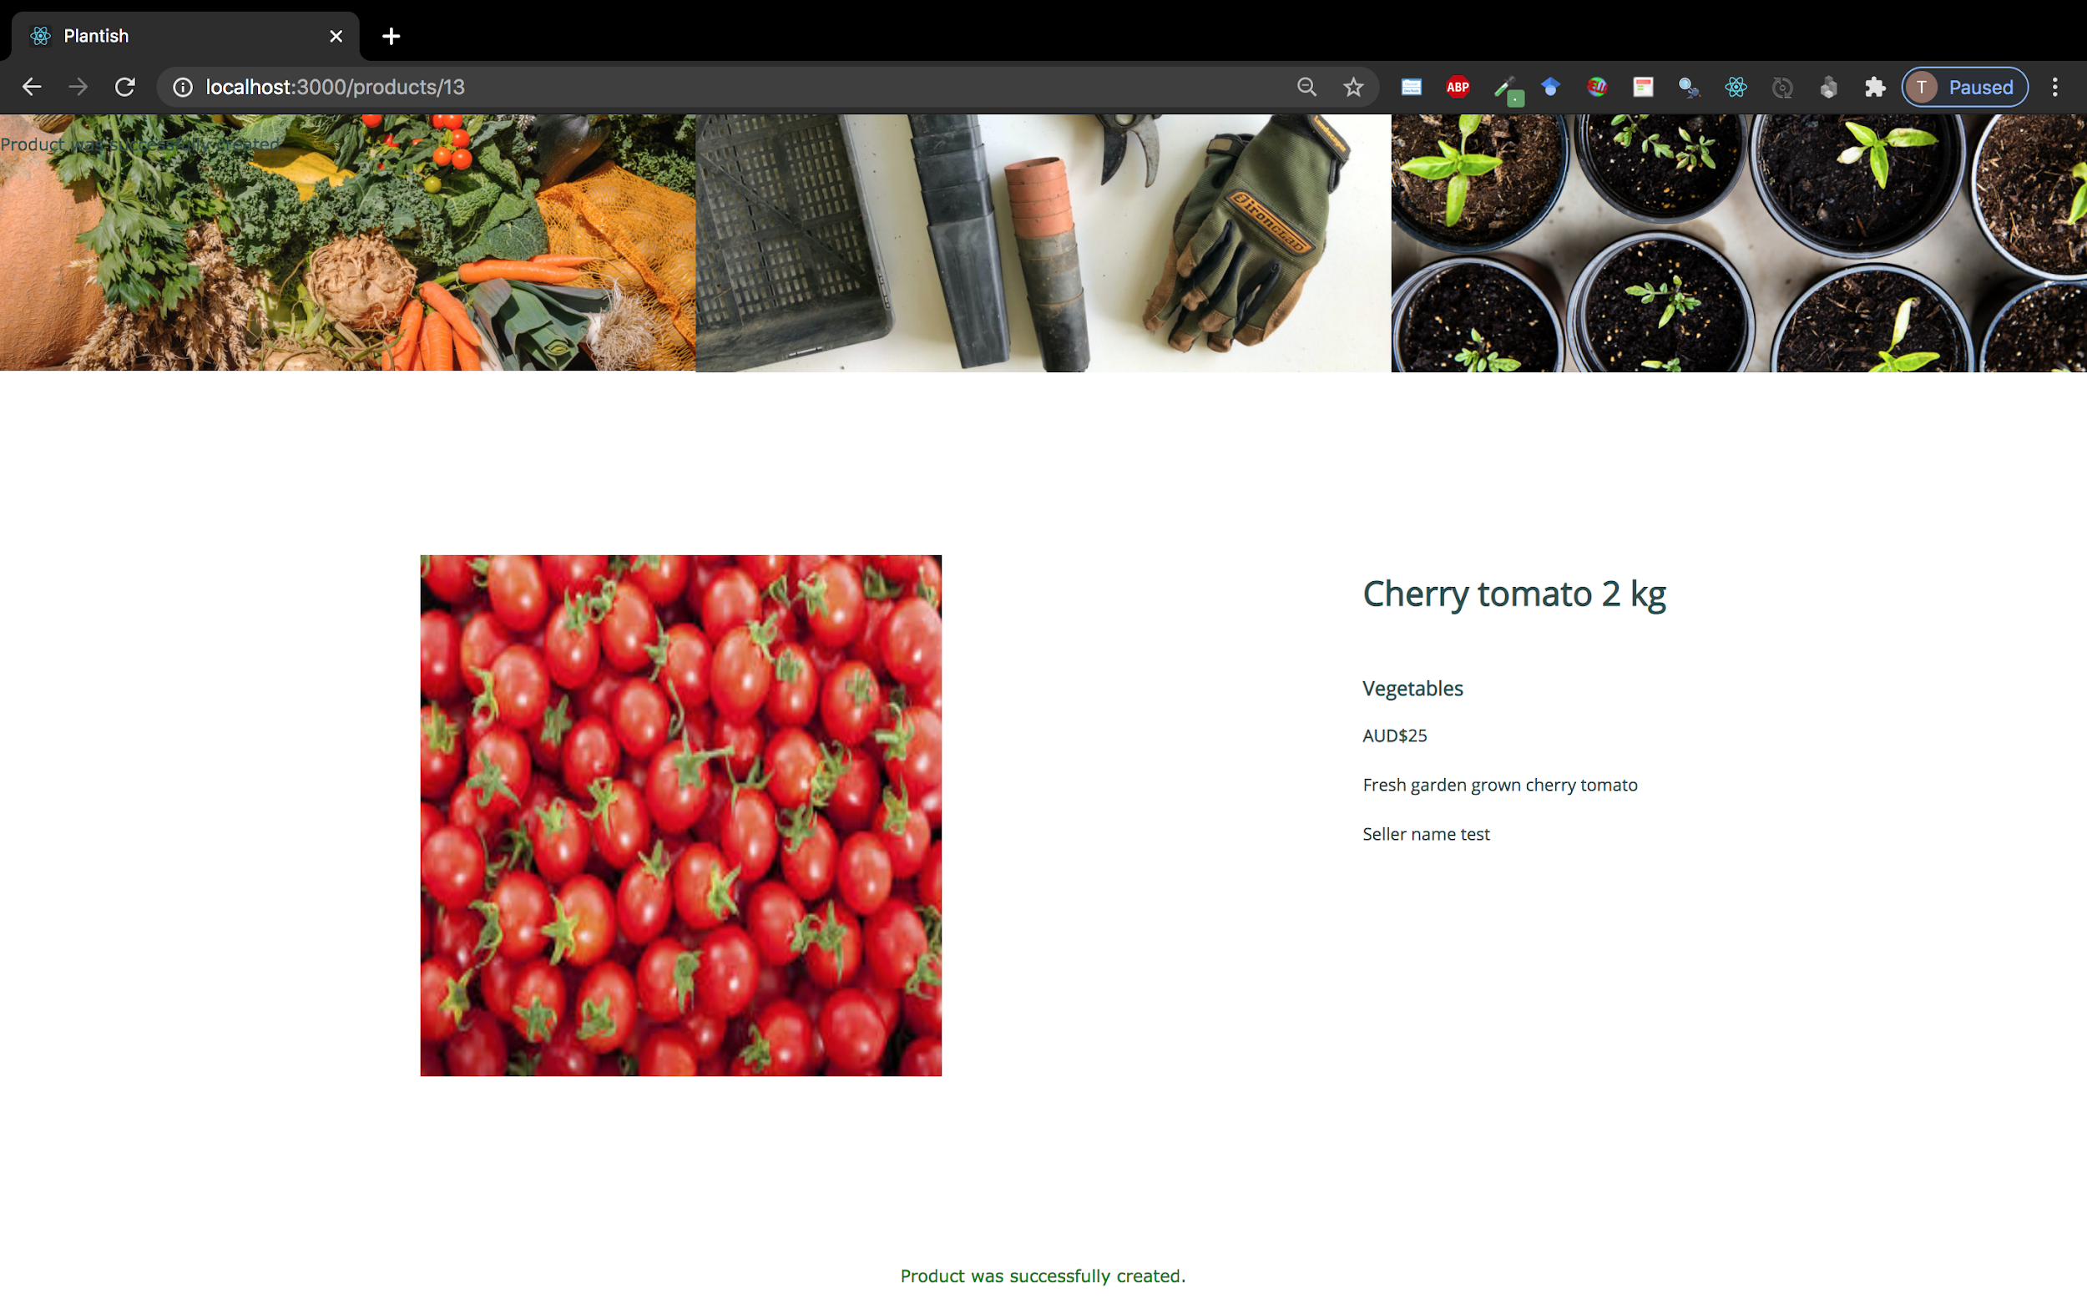

Slide 17
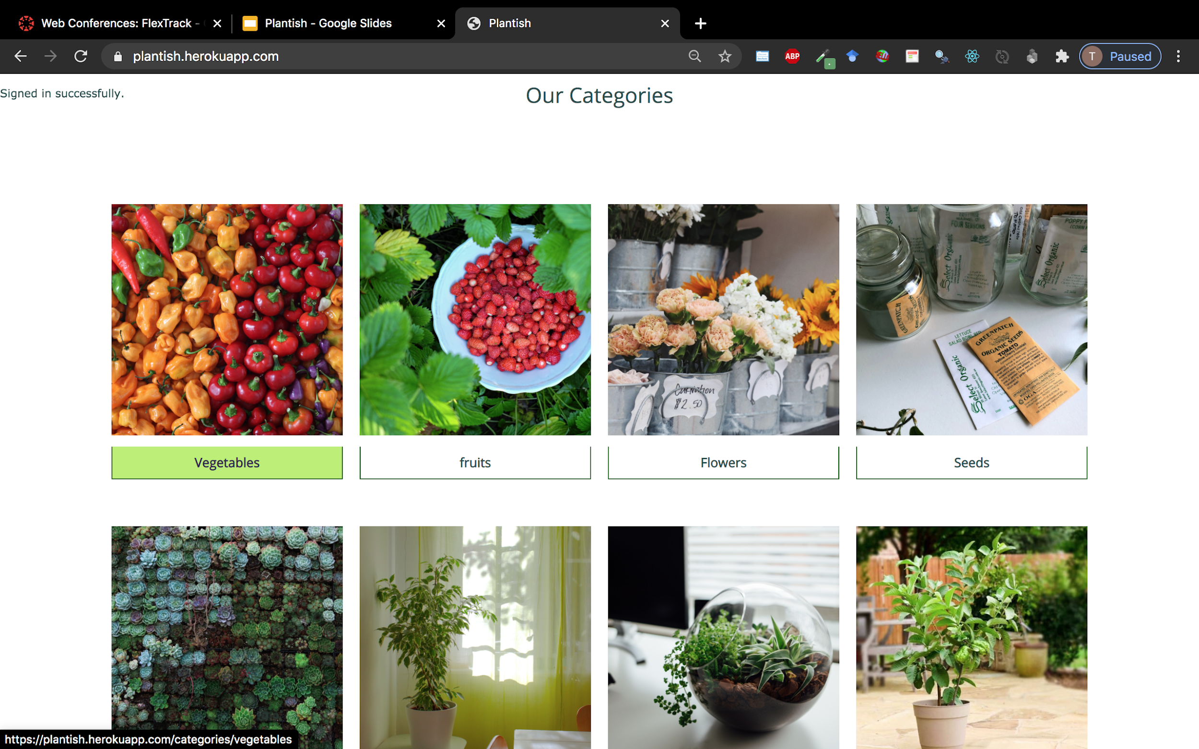

Slide 18
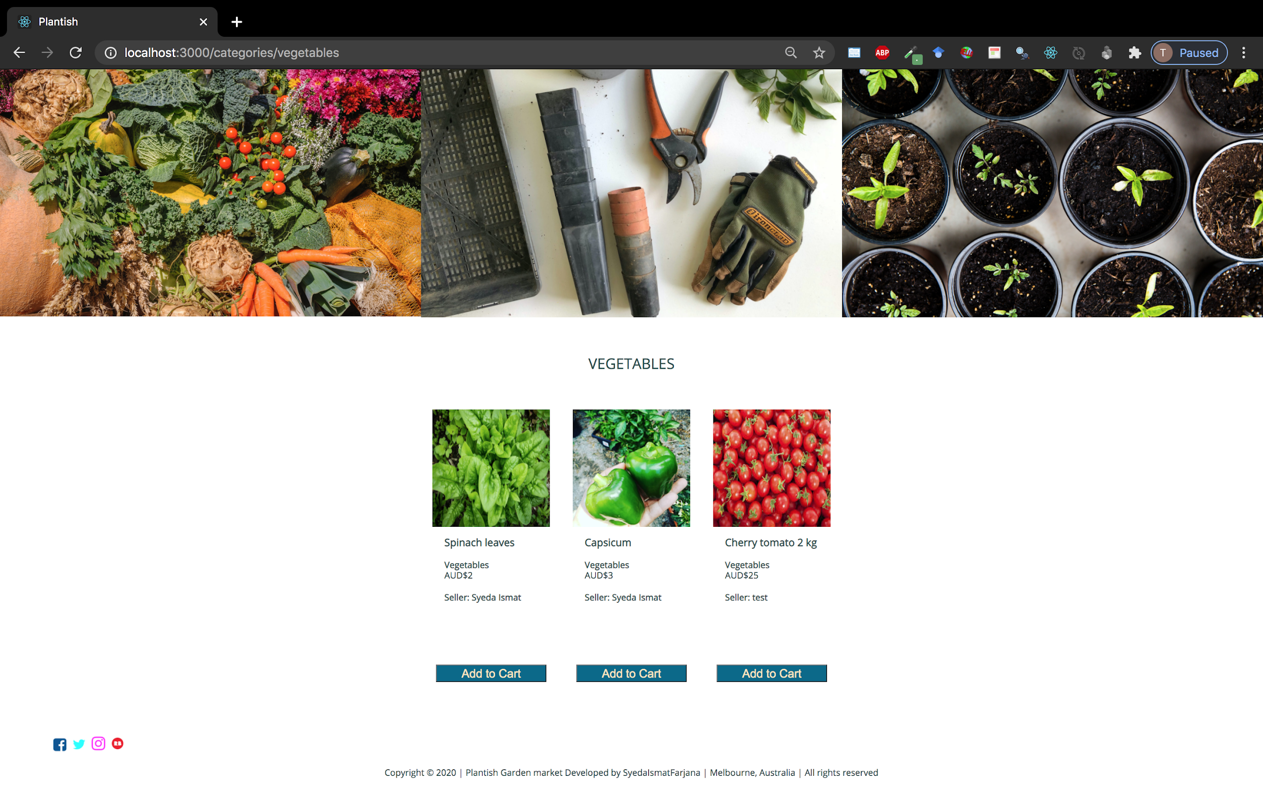

Slide 19
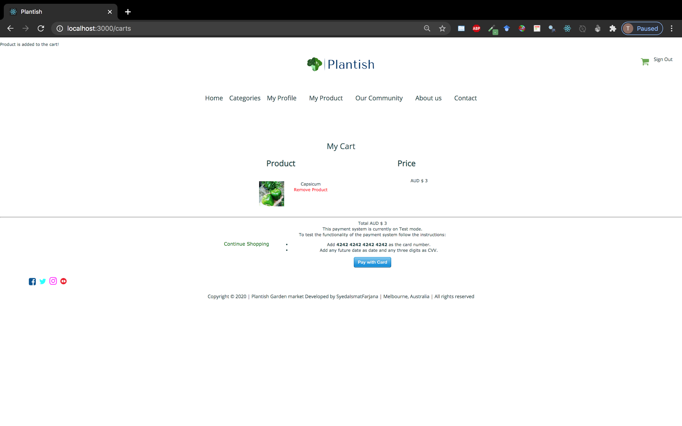

Slide 20
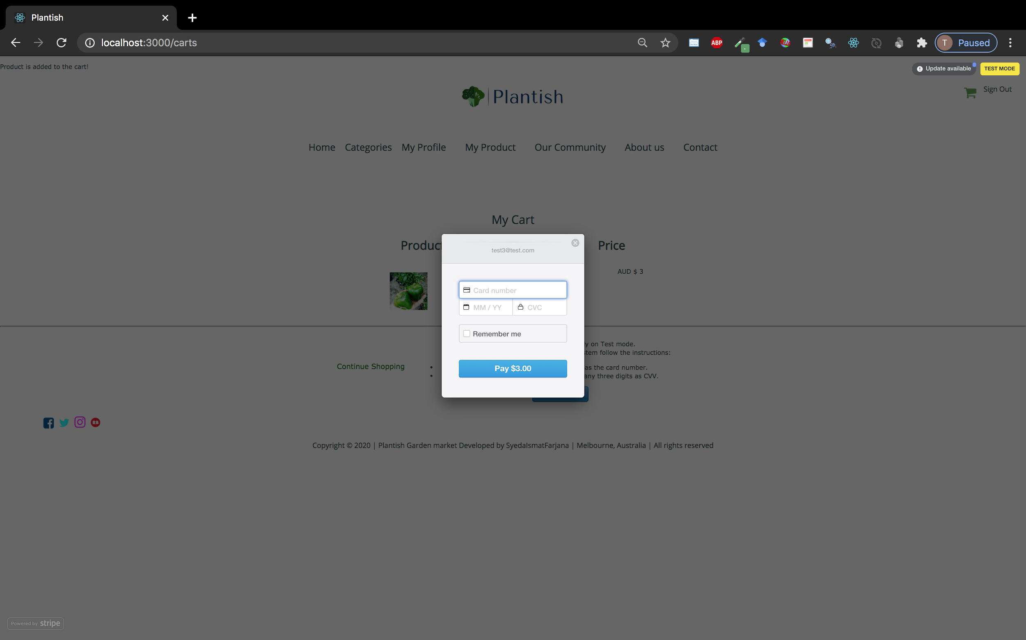

Slide 21
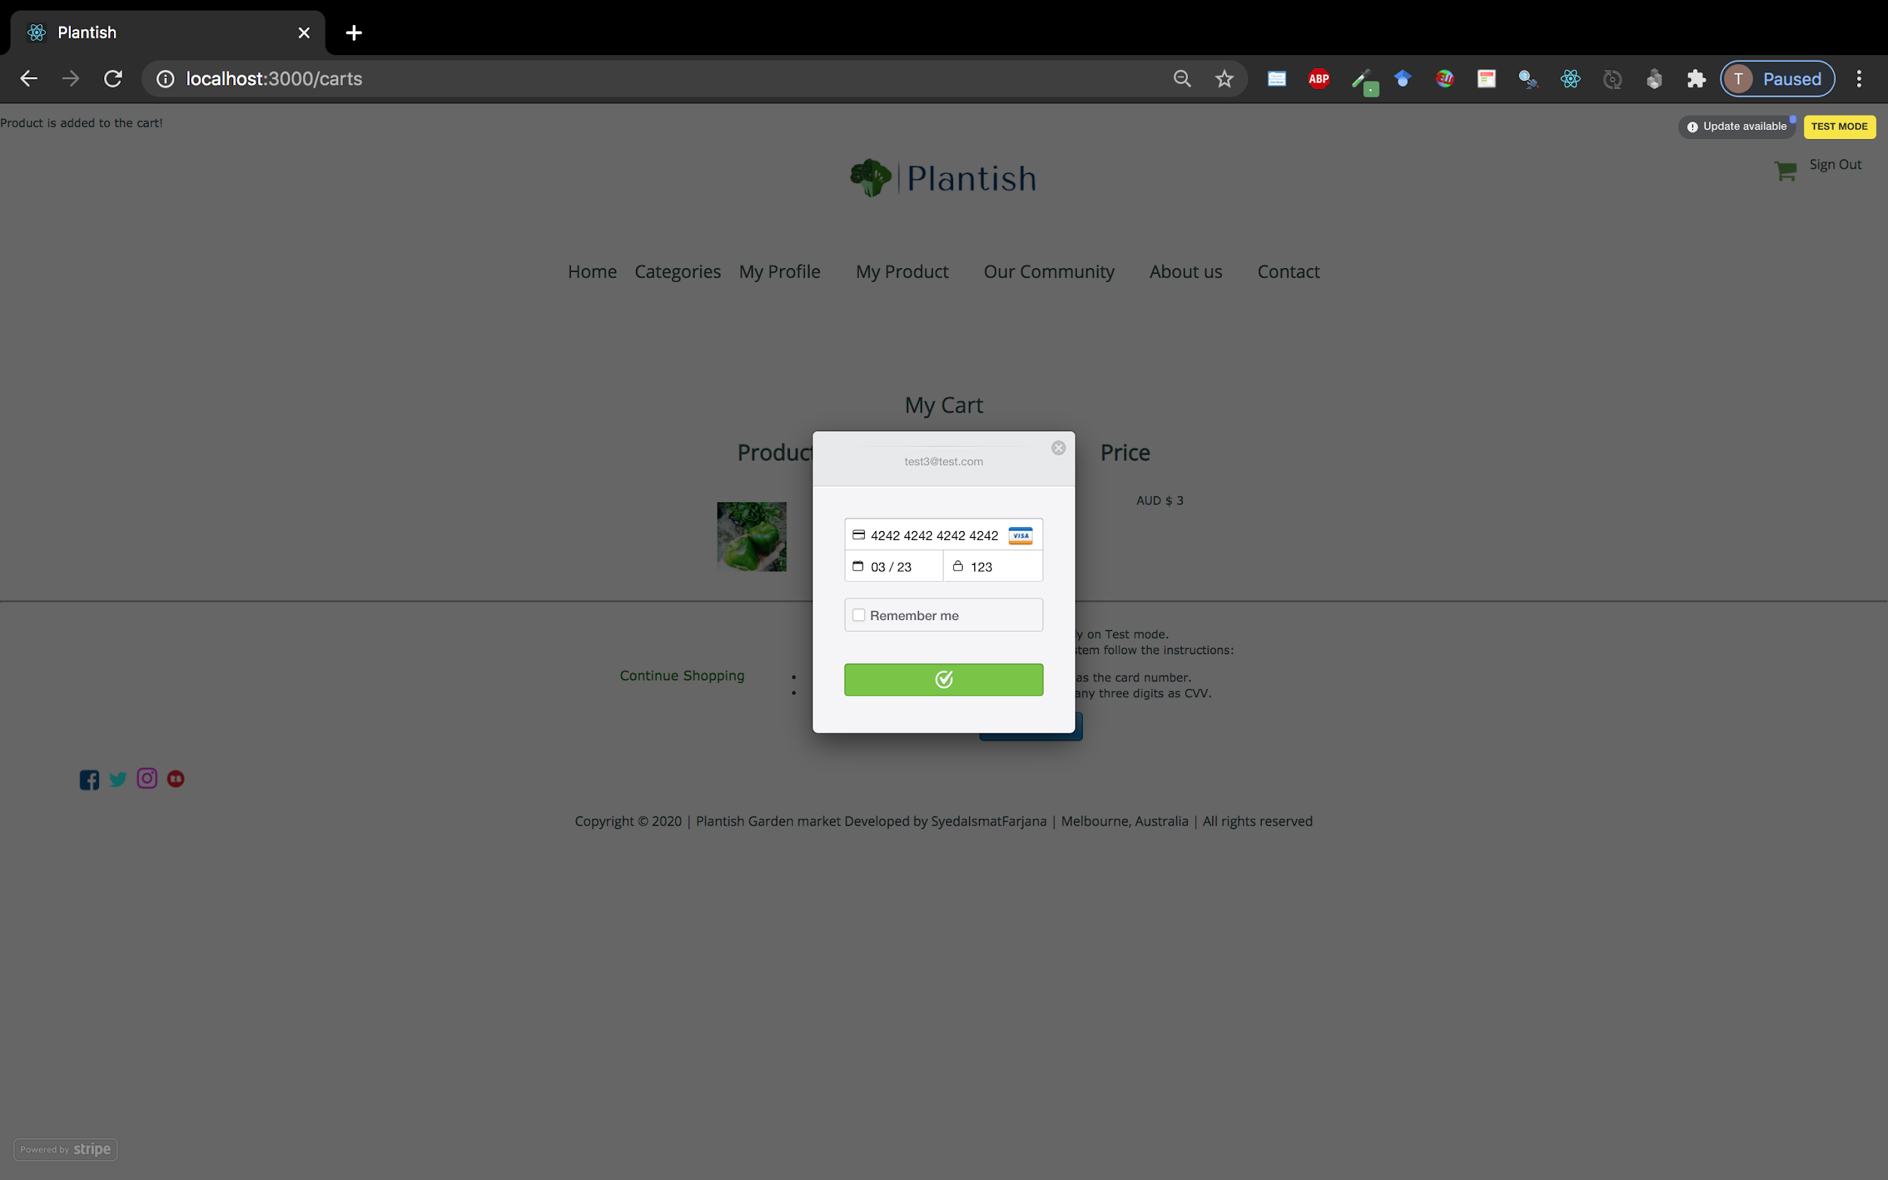

Slide 22
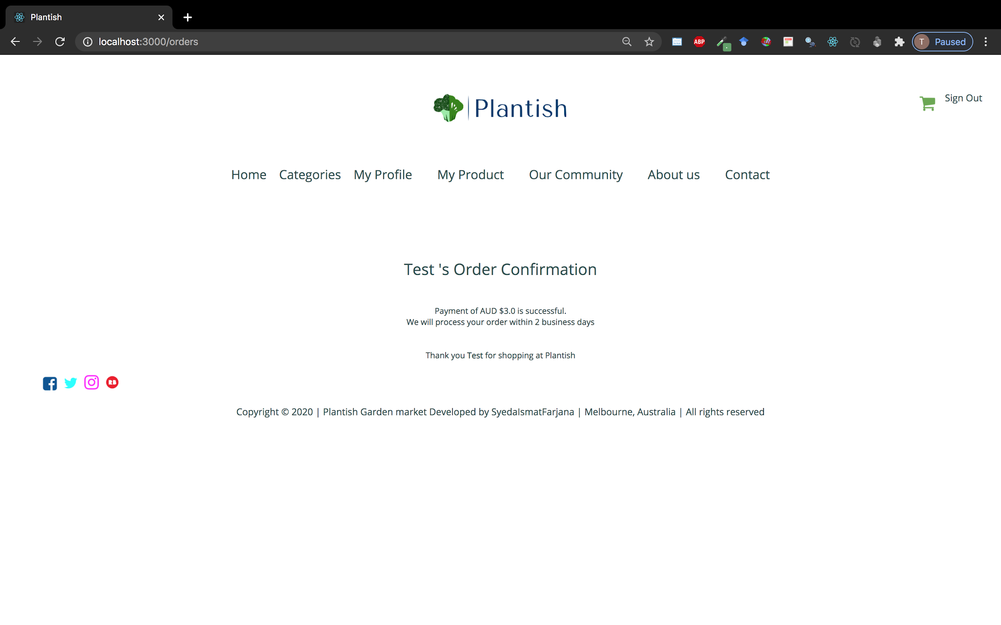

Slide 23
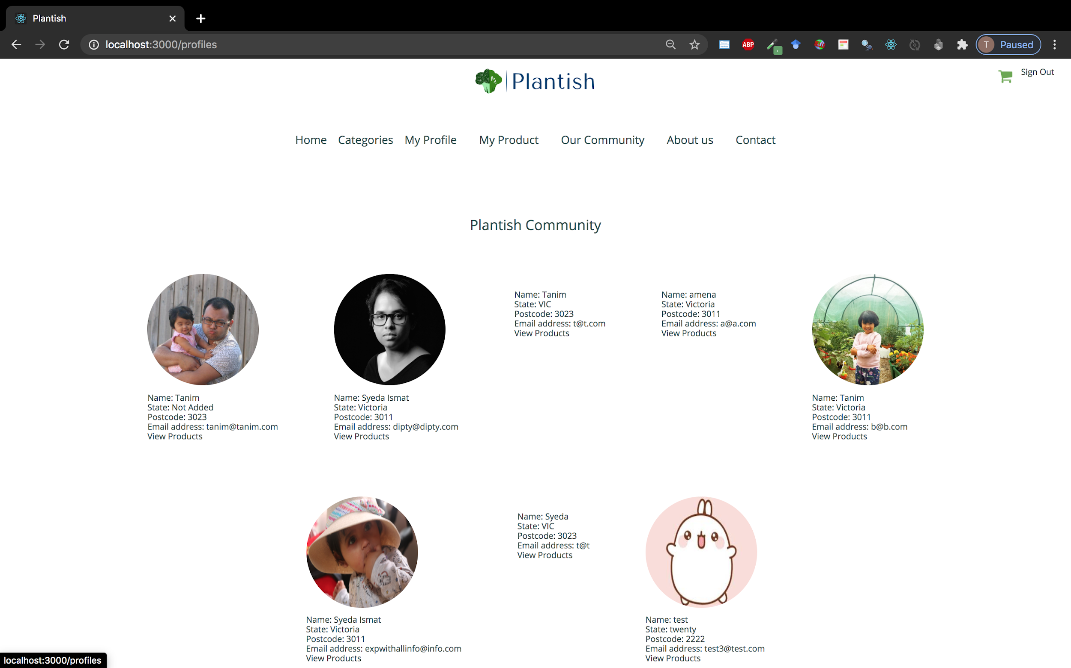

Slide 24
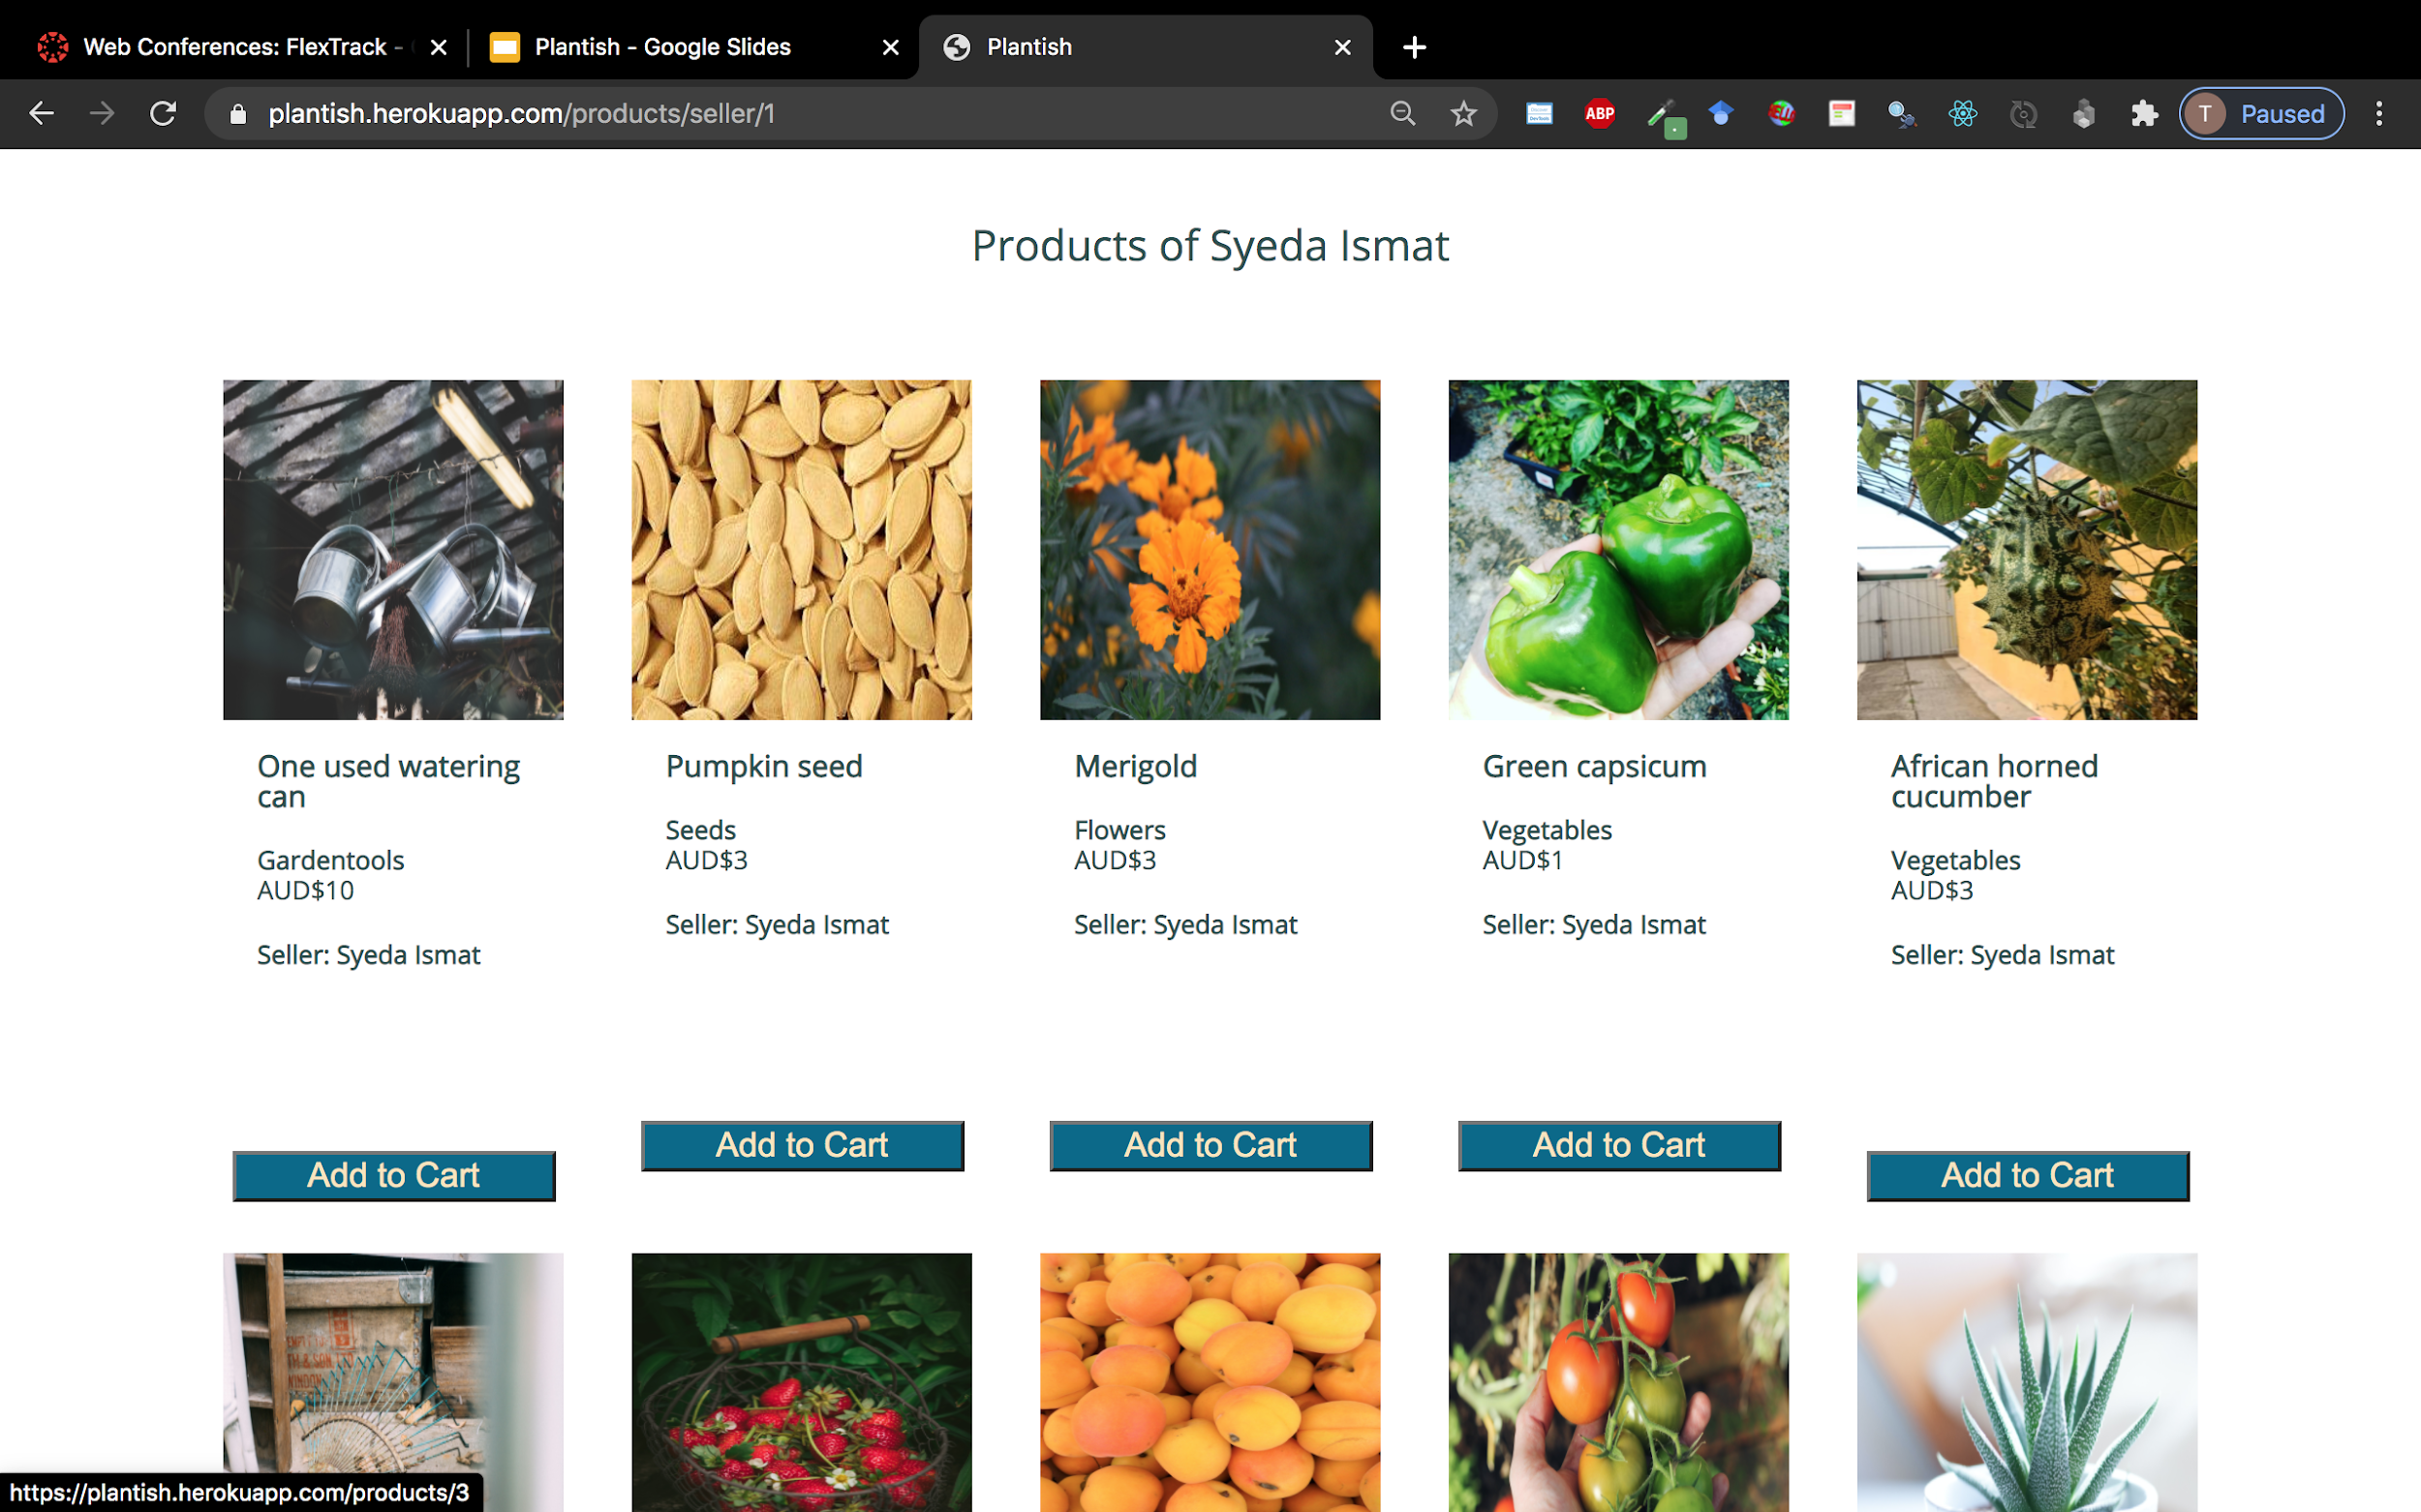

Slide 25
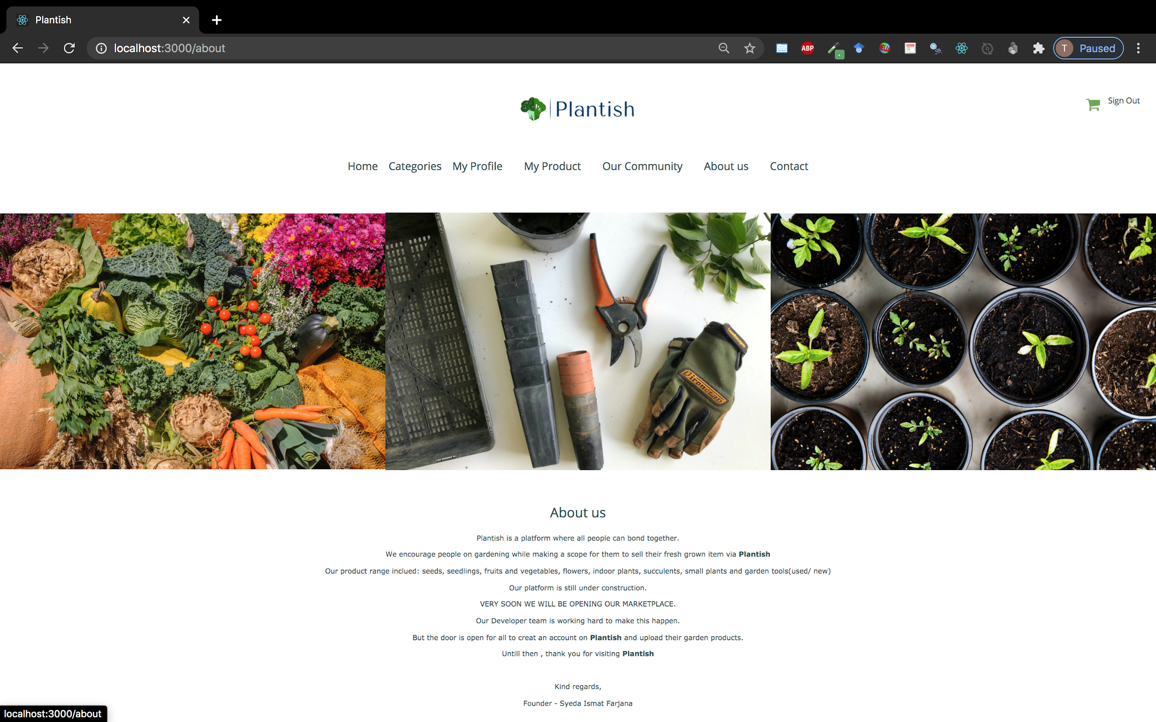

Slide 26
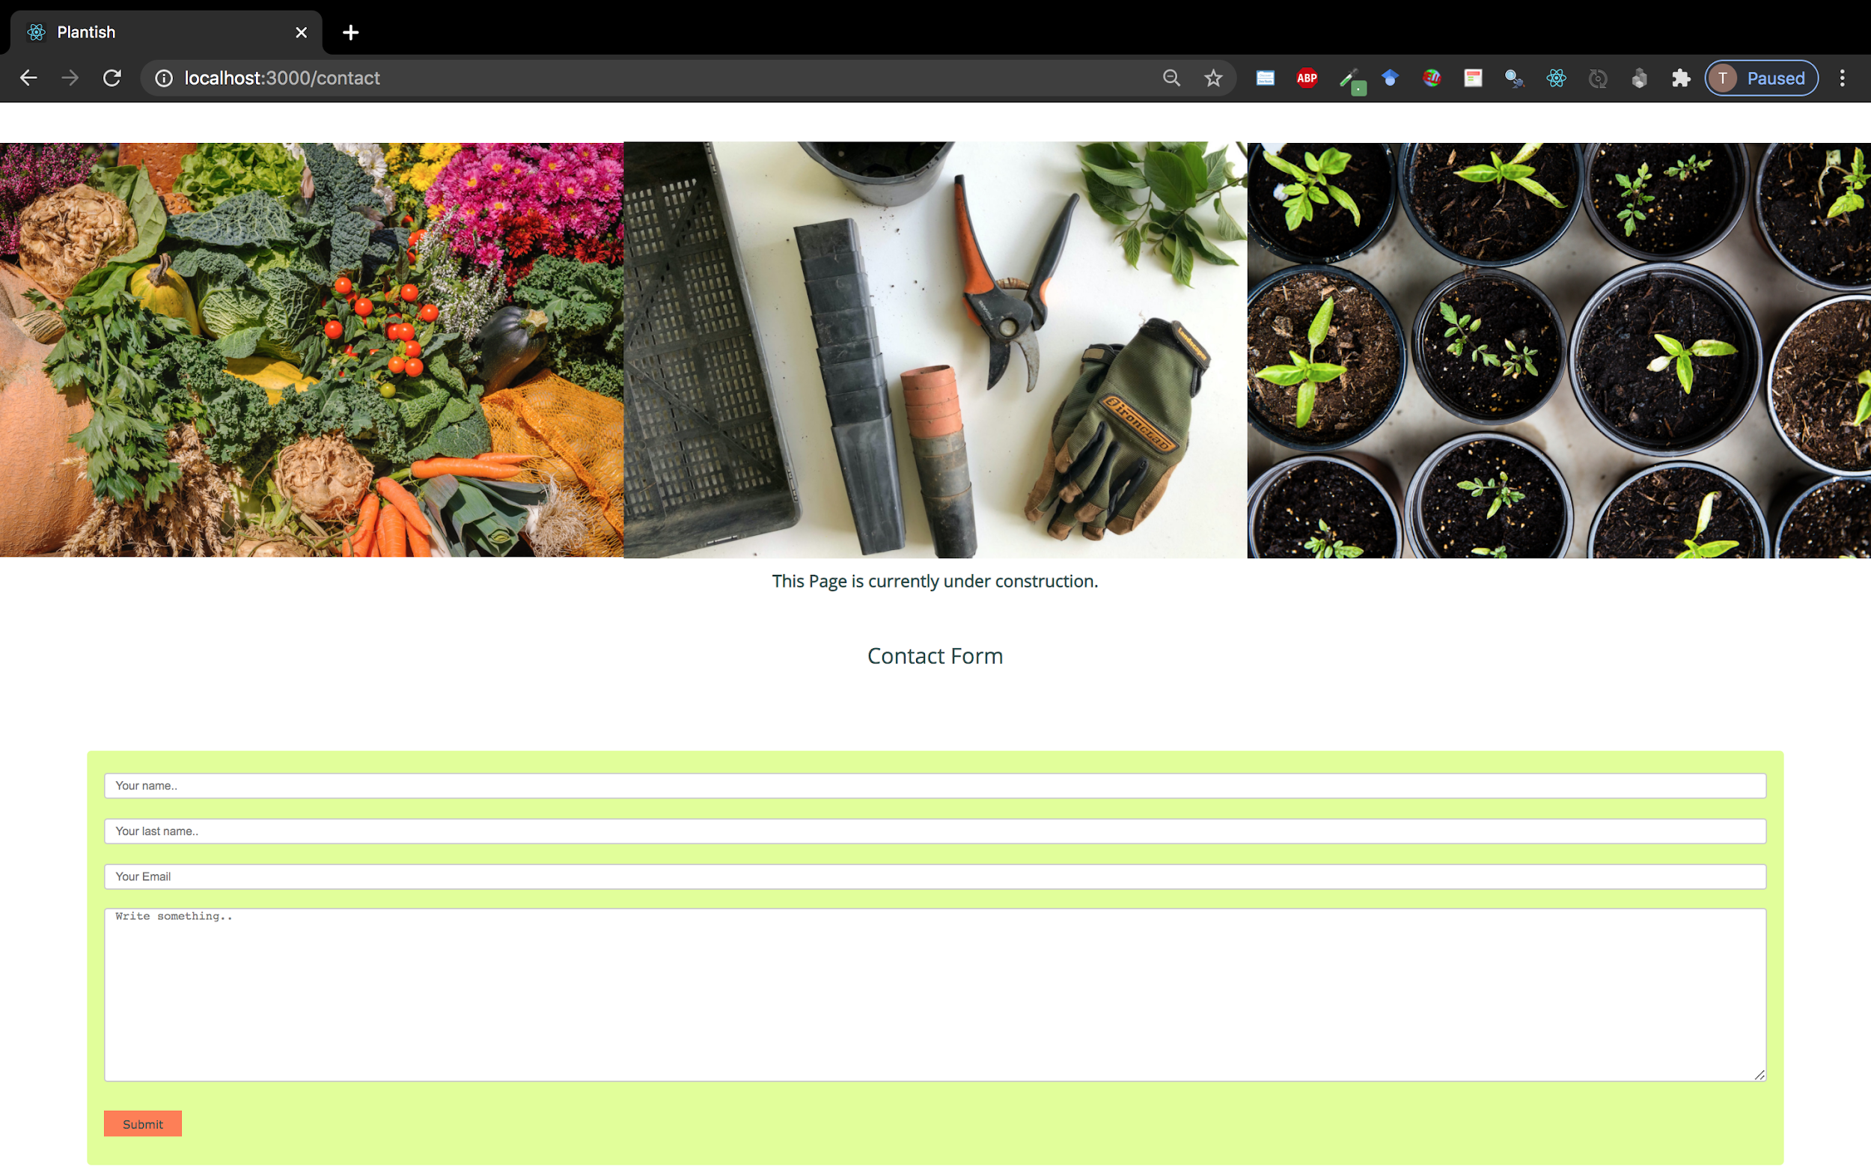

Slide 27
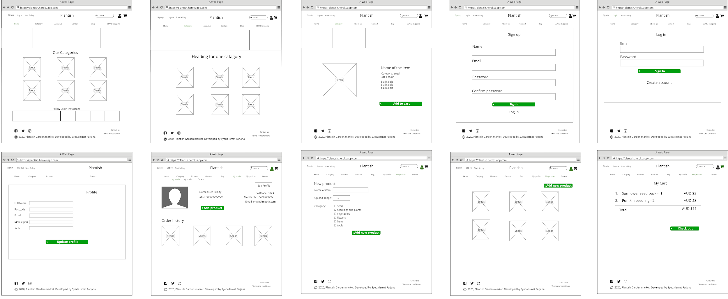
Wireframes(Desktop)

Slide 28
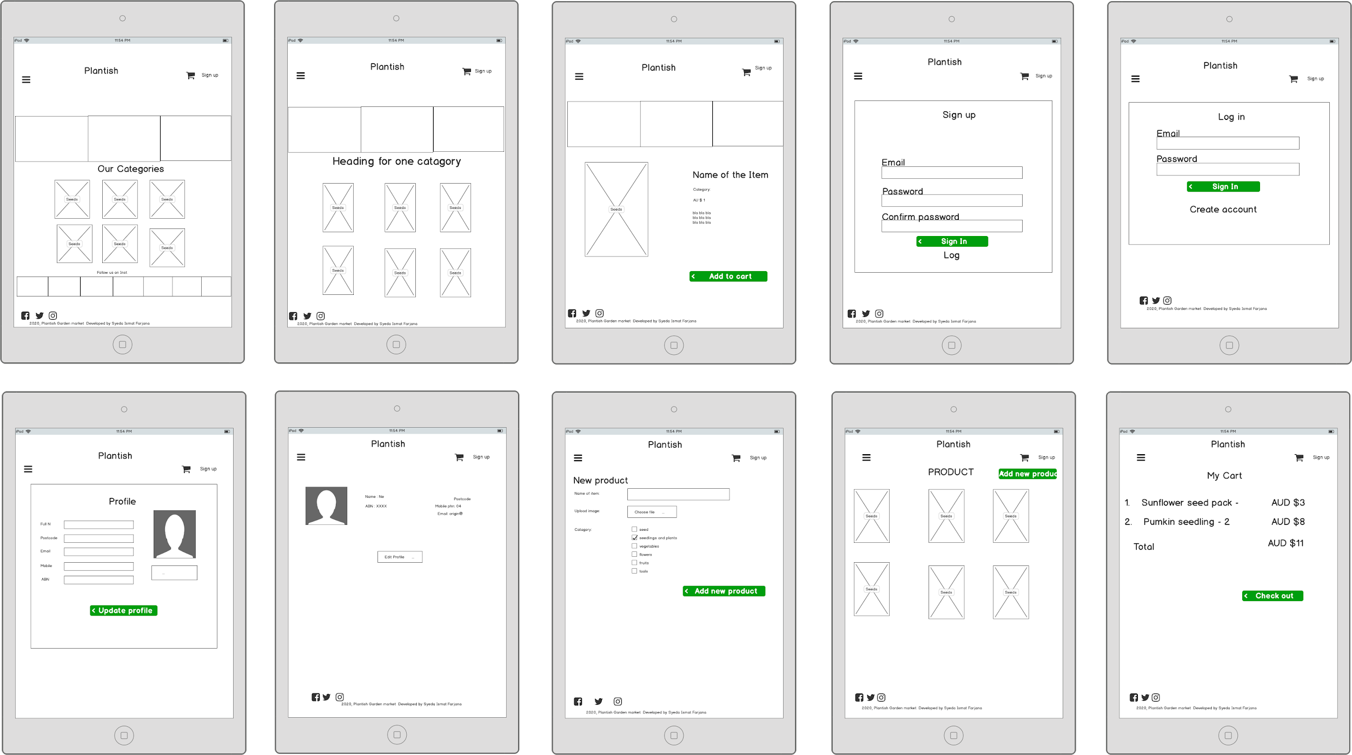
Wireframes(Tablet)

Slide 29
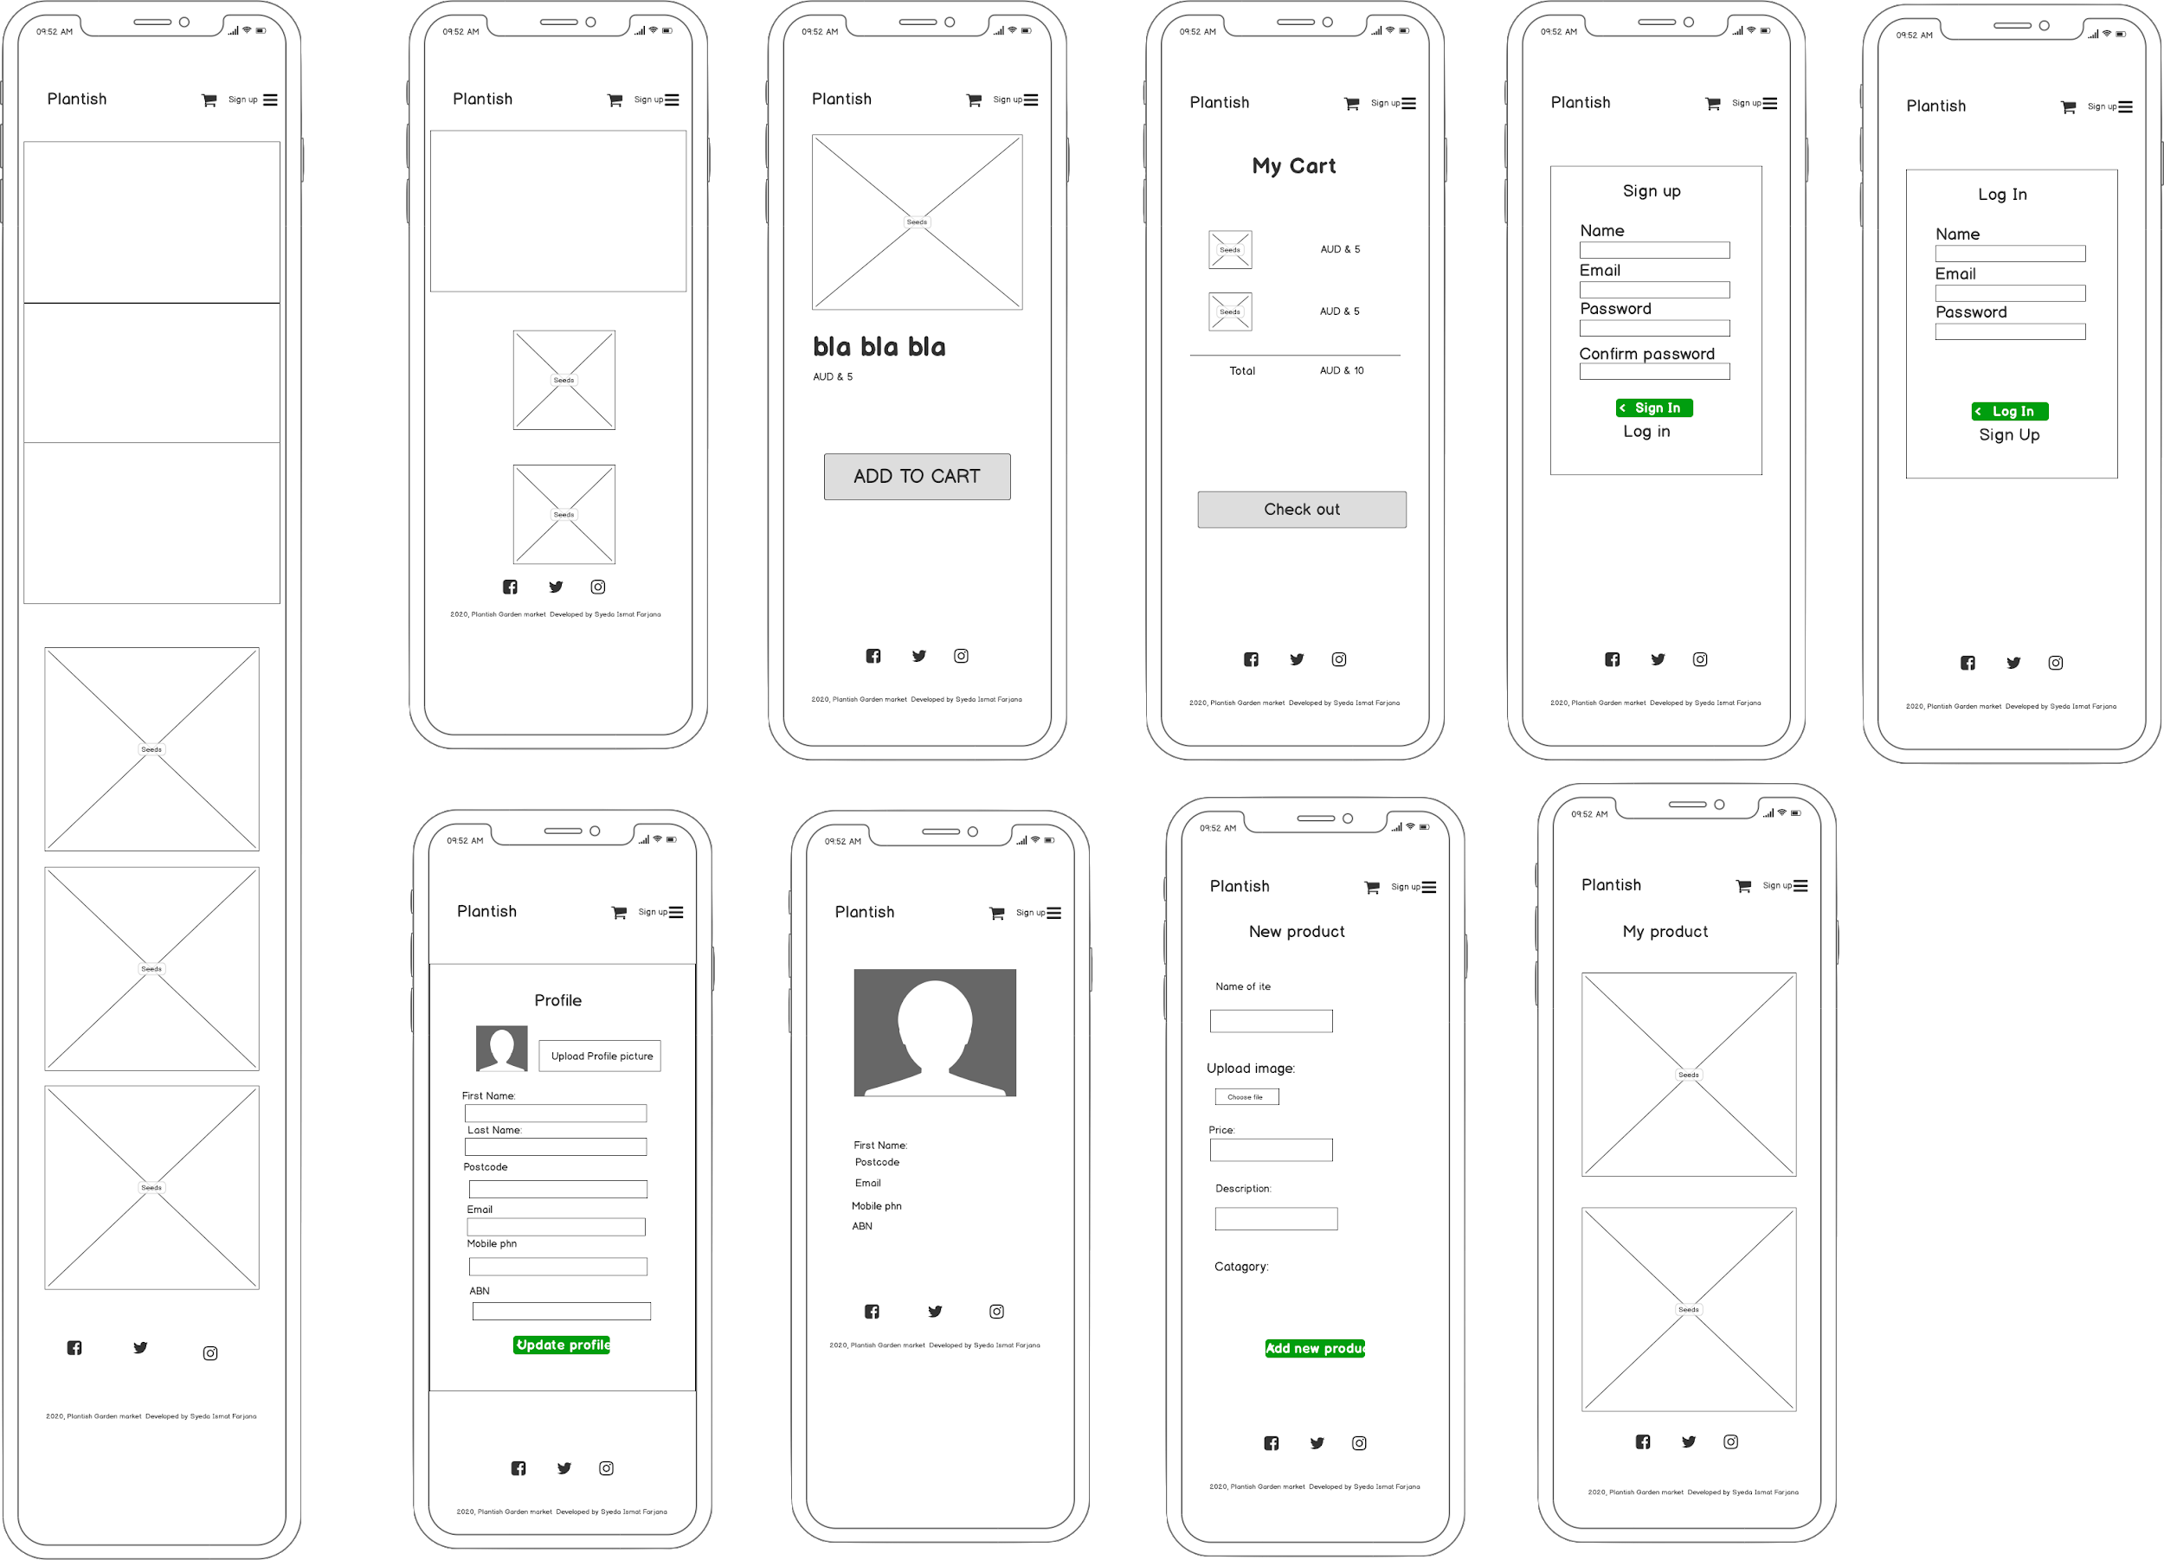
Wireframes(Mobile phone)

Slide 30
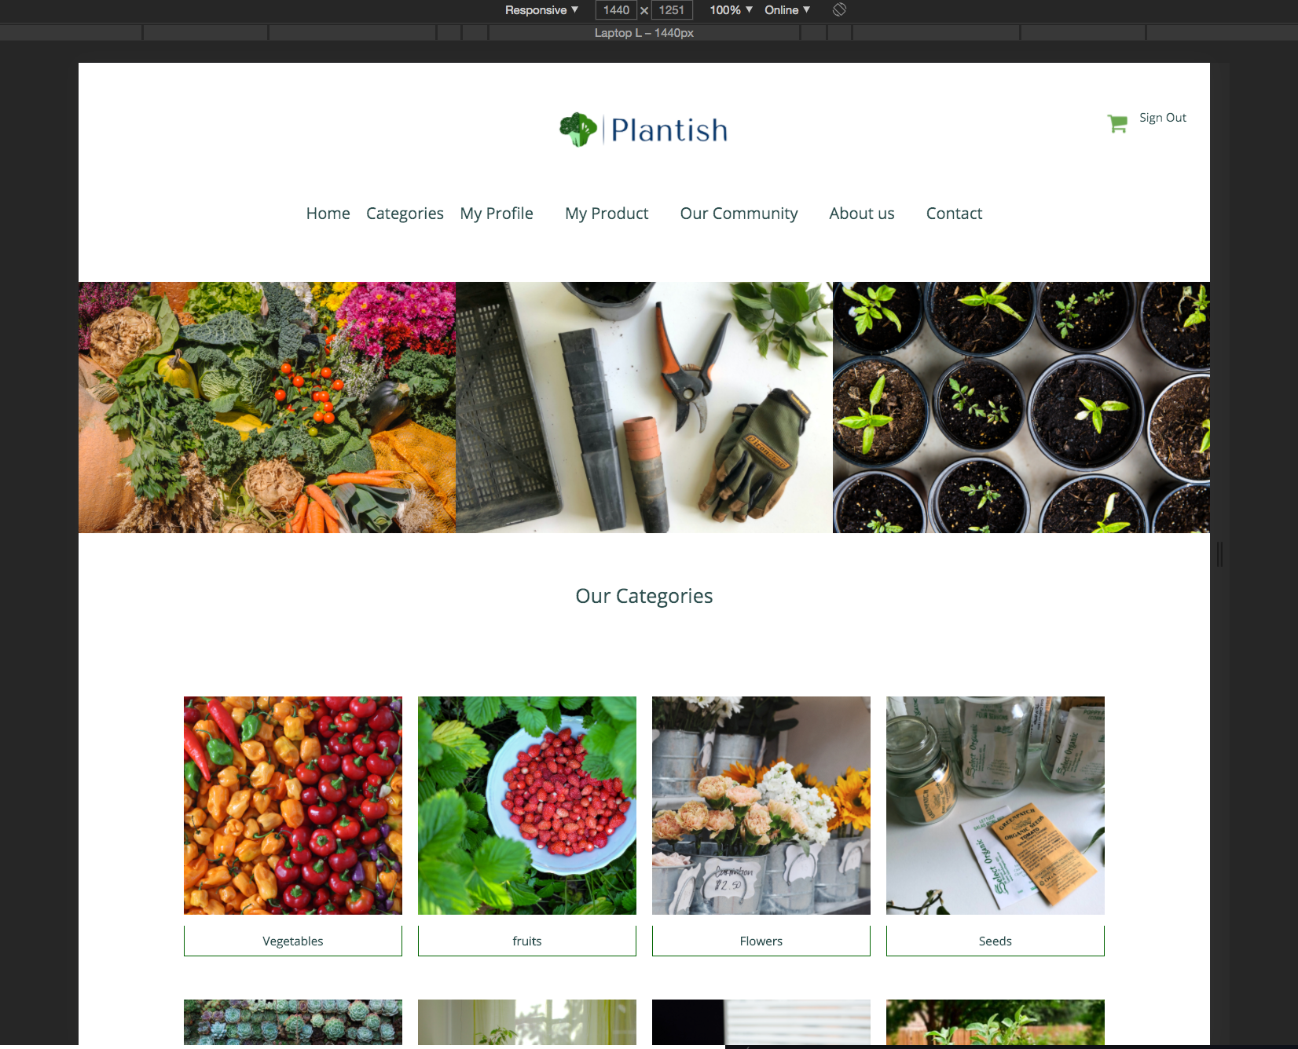
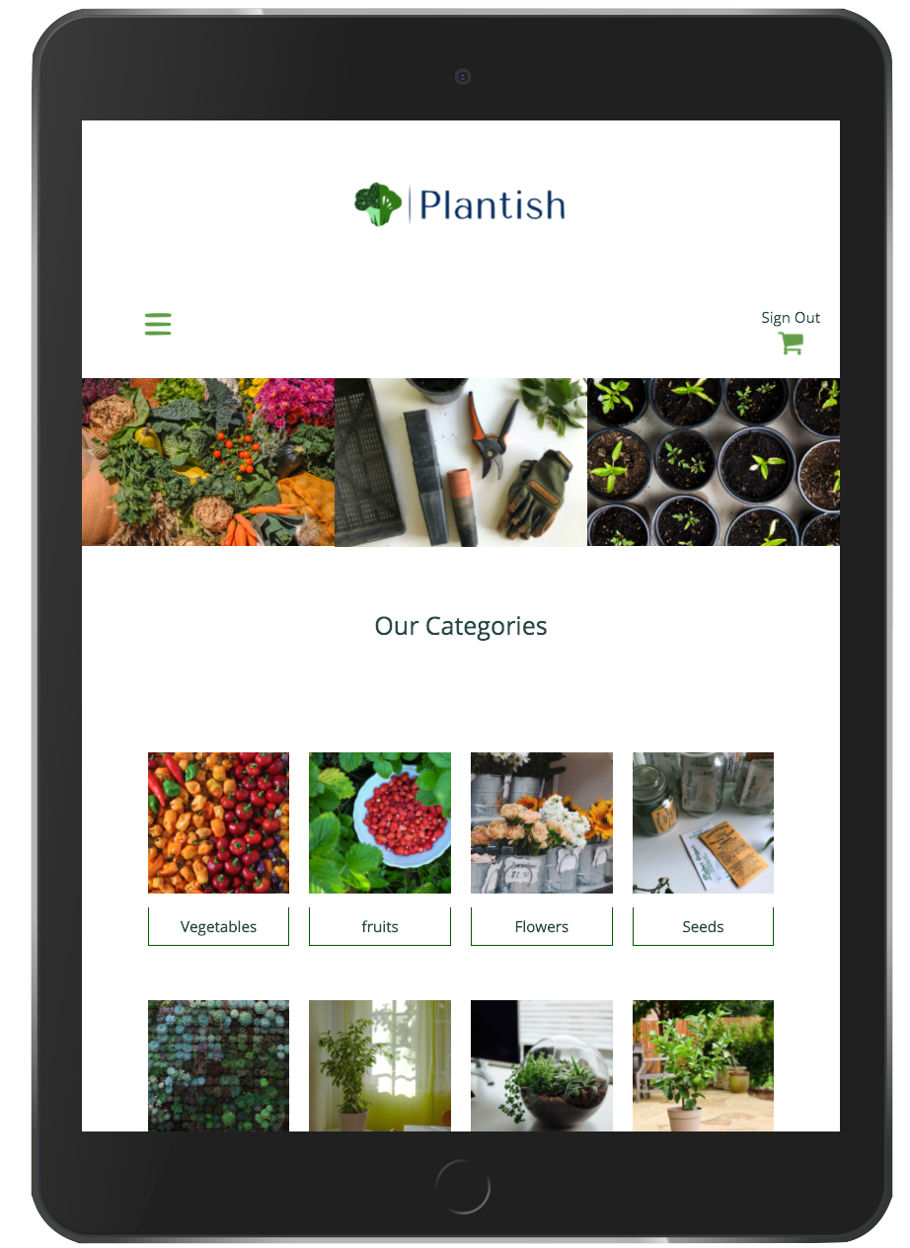
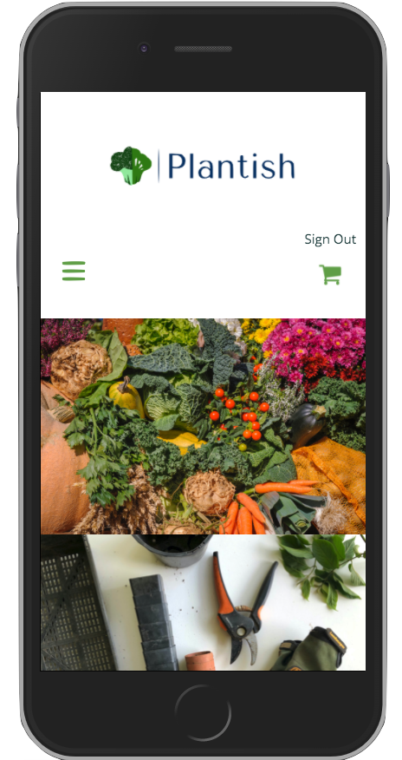
Screenshots
Home

Slide 31
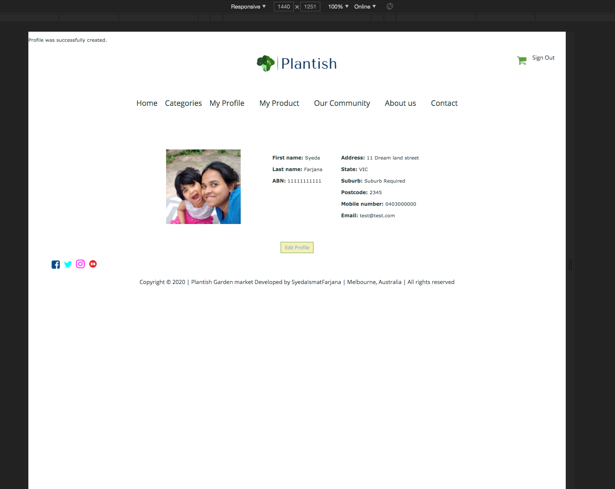
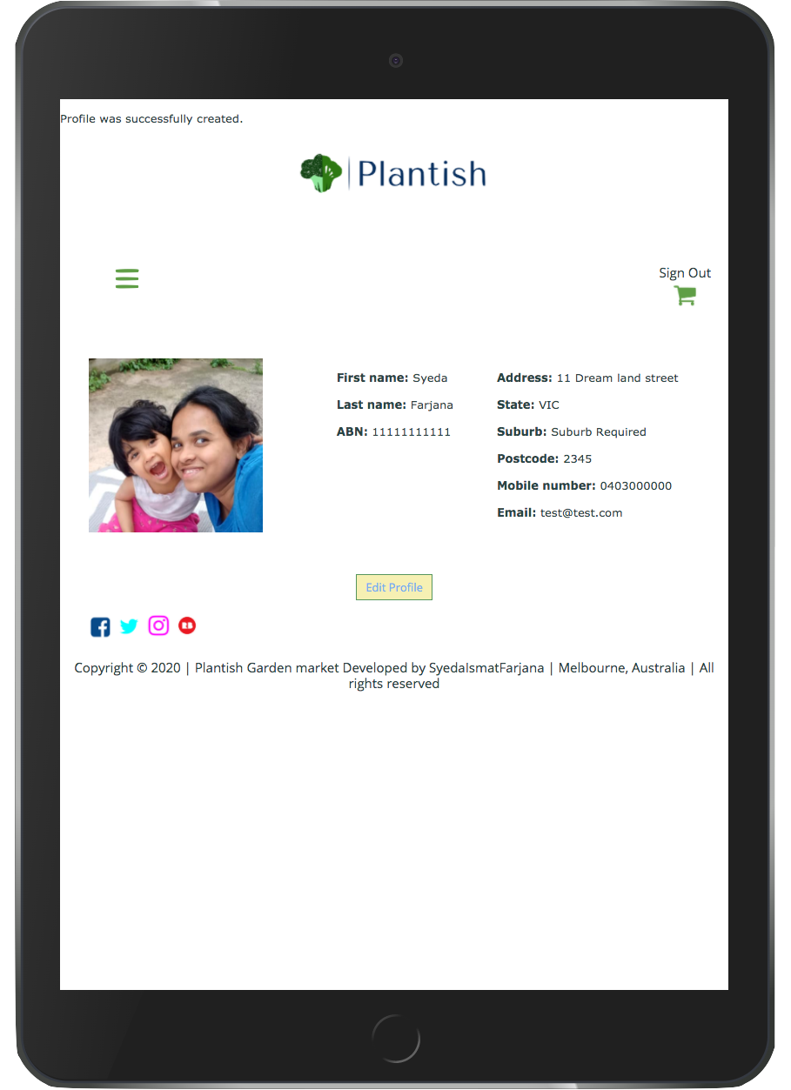
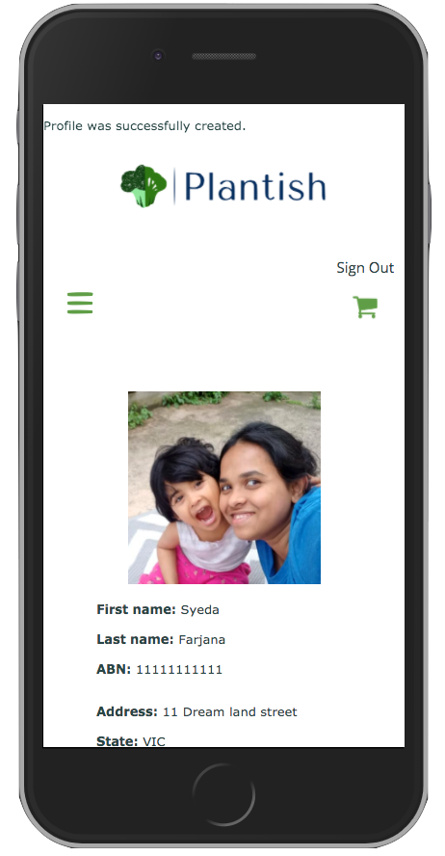
Screenshots
My Profile

Slide 32
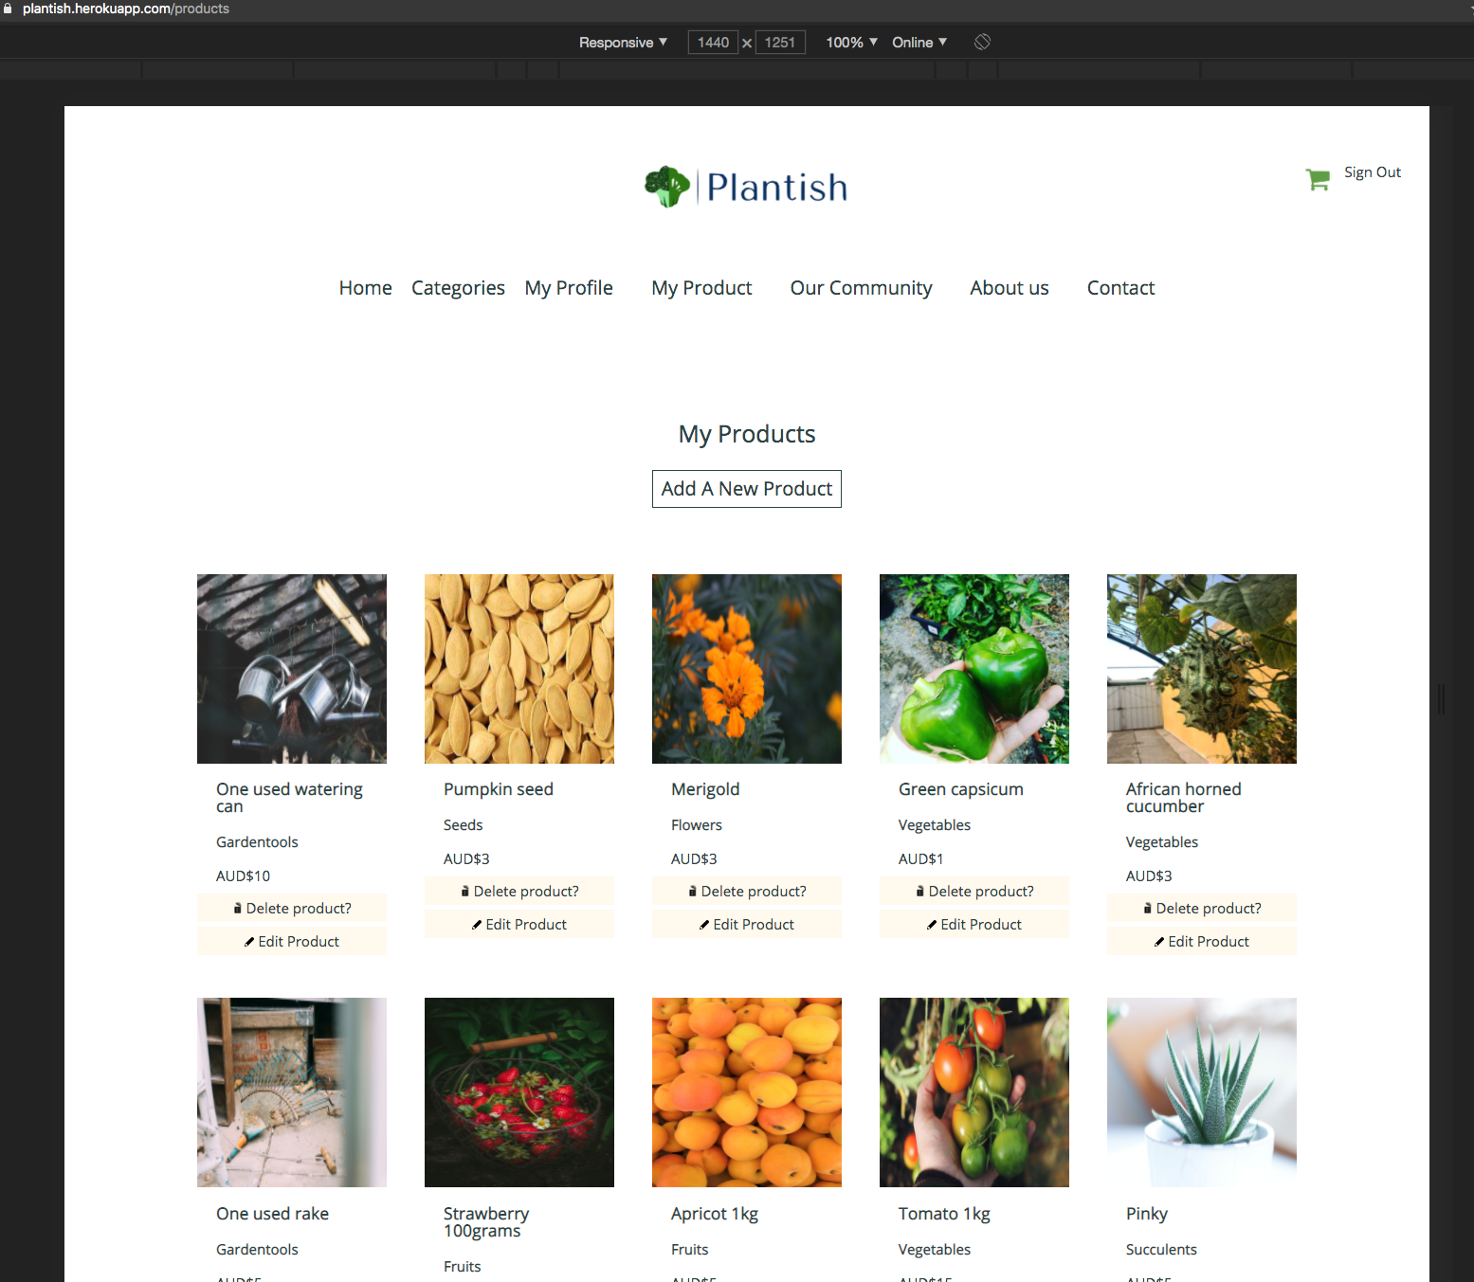
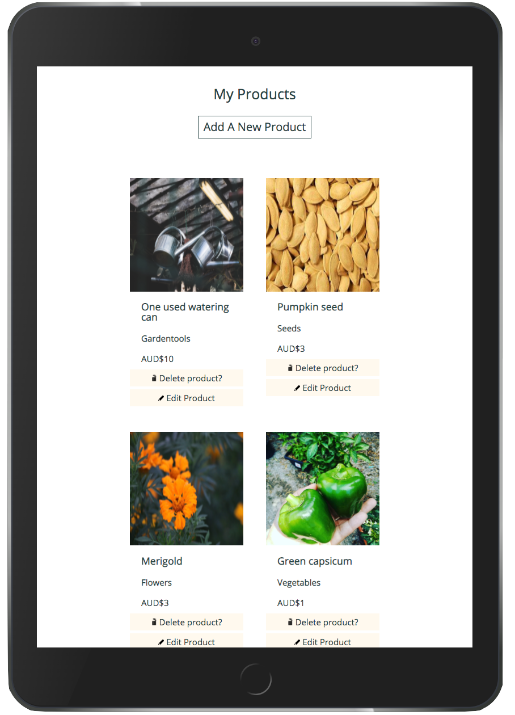
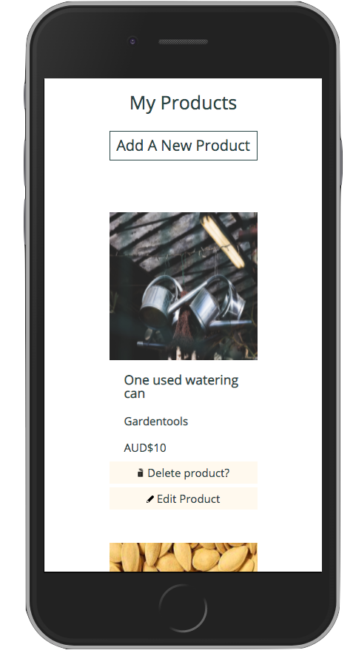
Screenshots
My Products

Slide 33
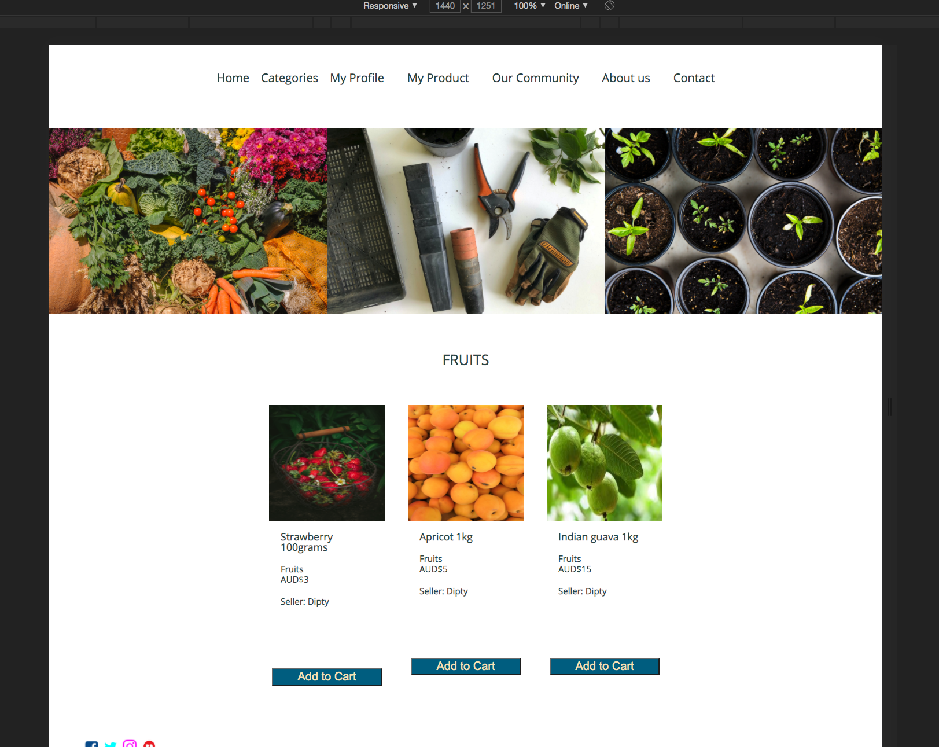
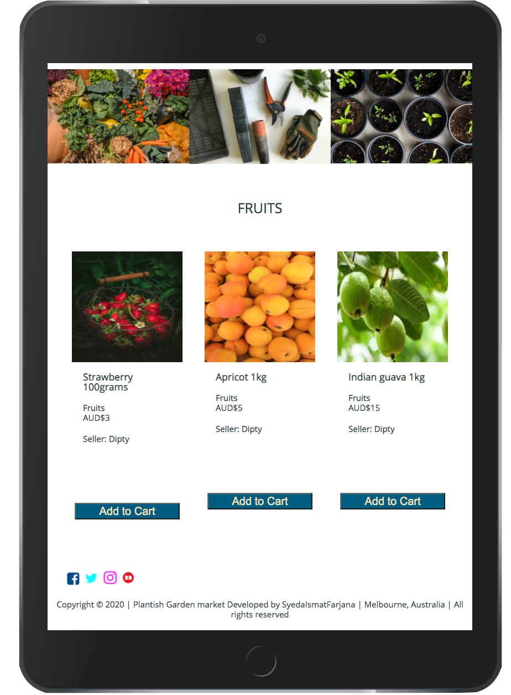
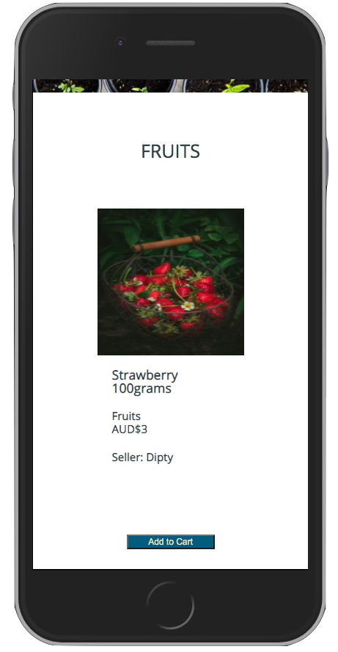
Screenshots
Each Category page

Slide 34
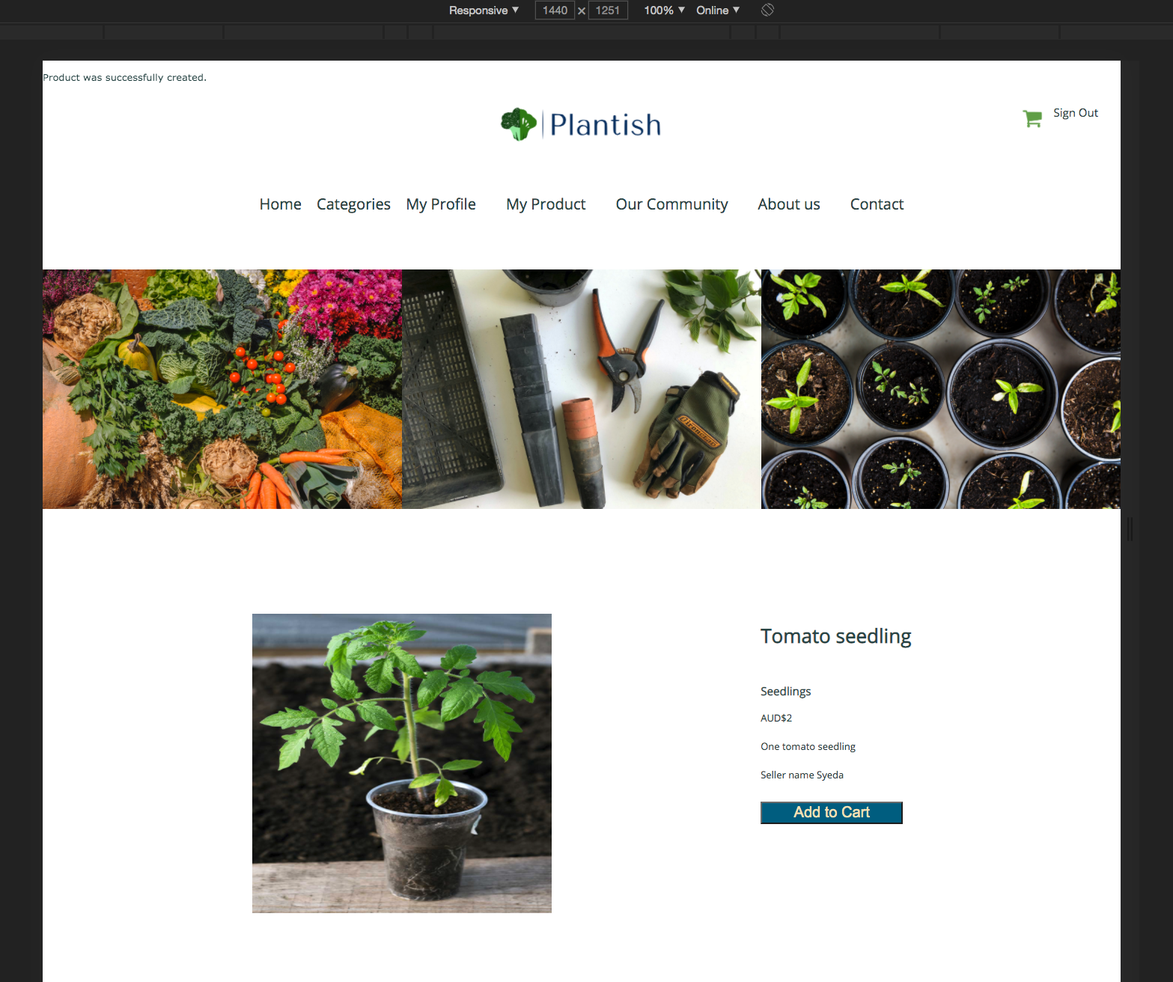
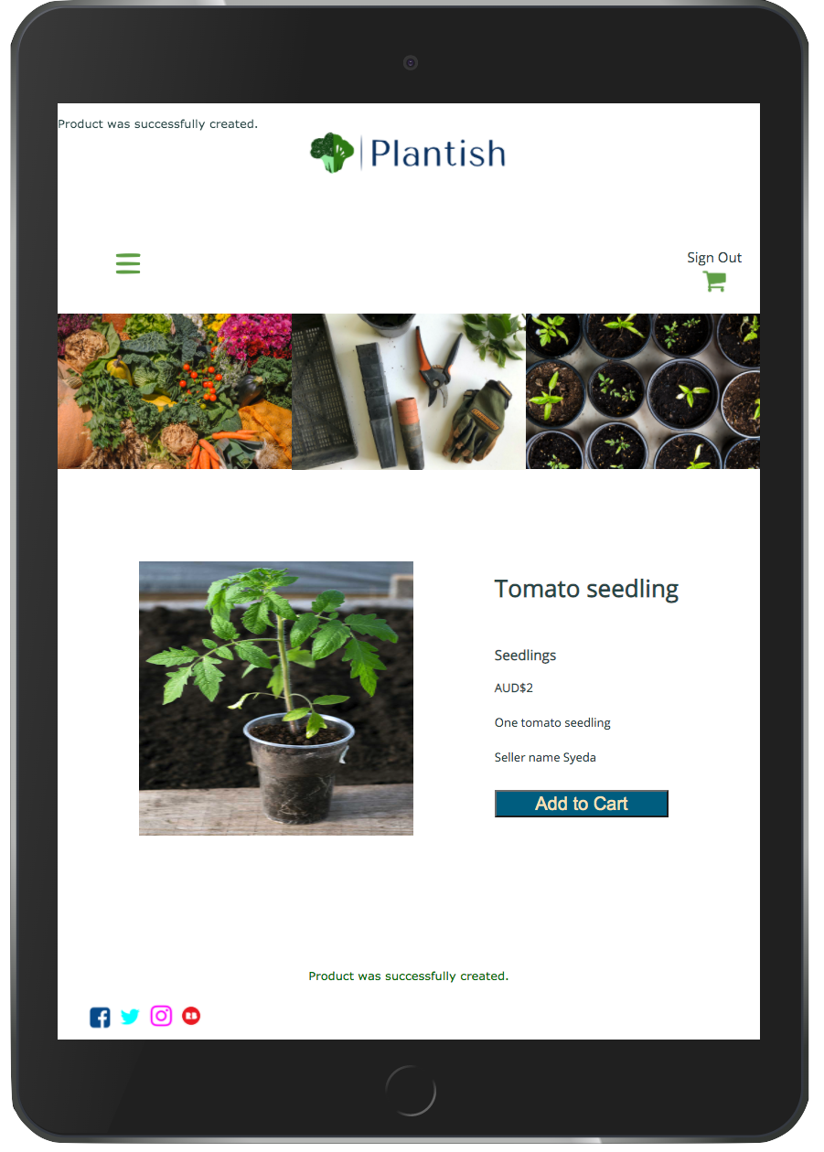
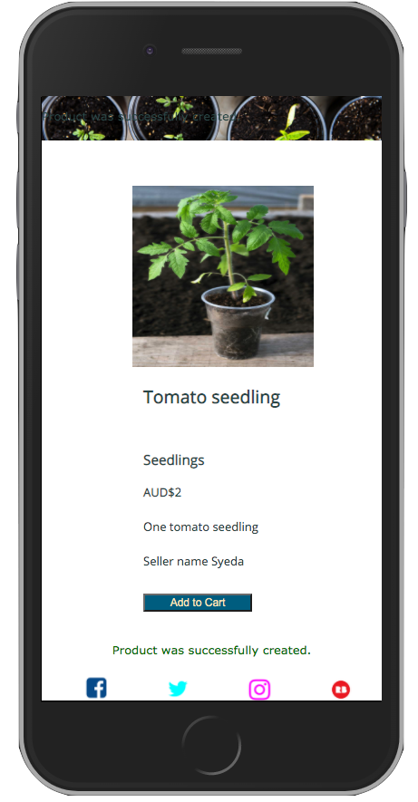
Screenshots
Each Product

Slide 35
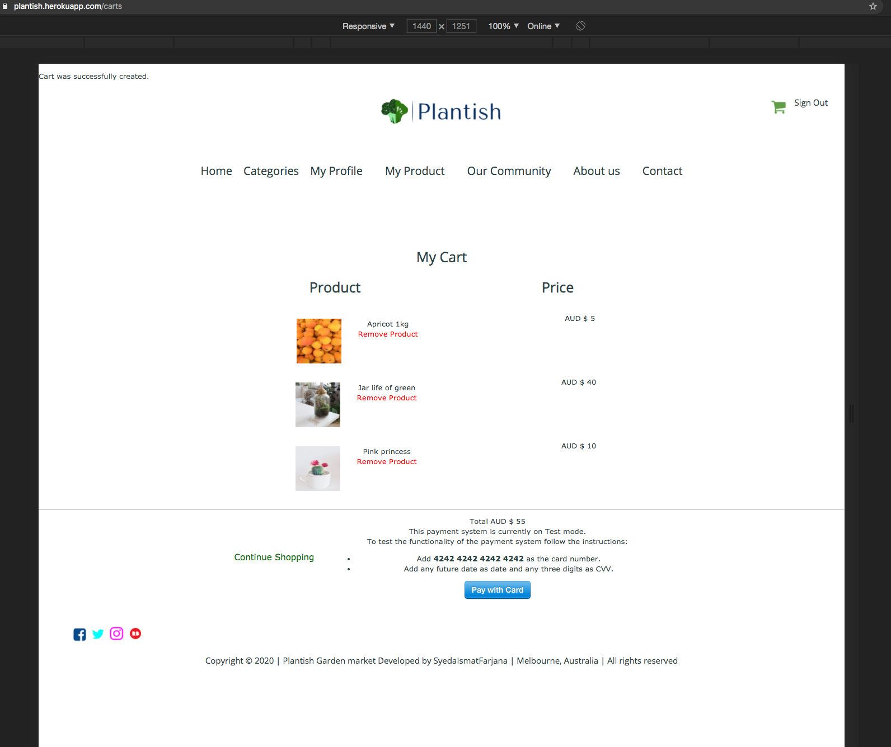
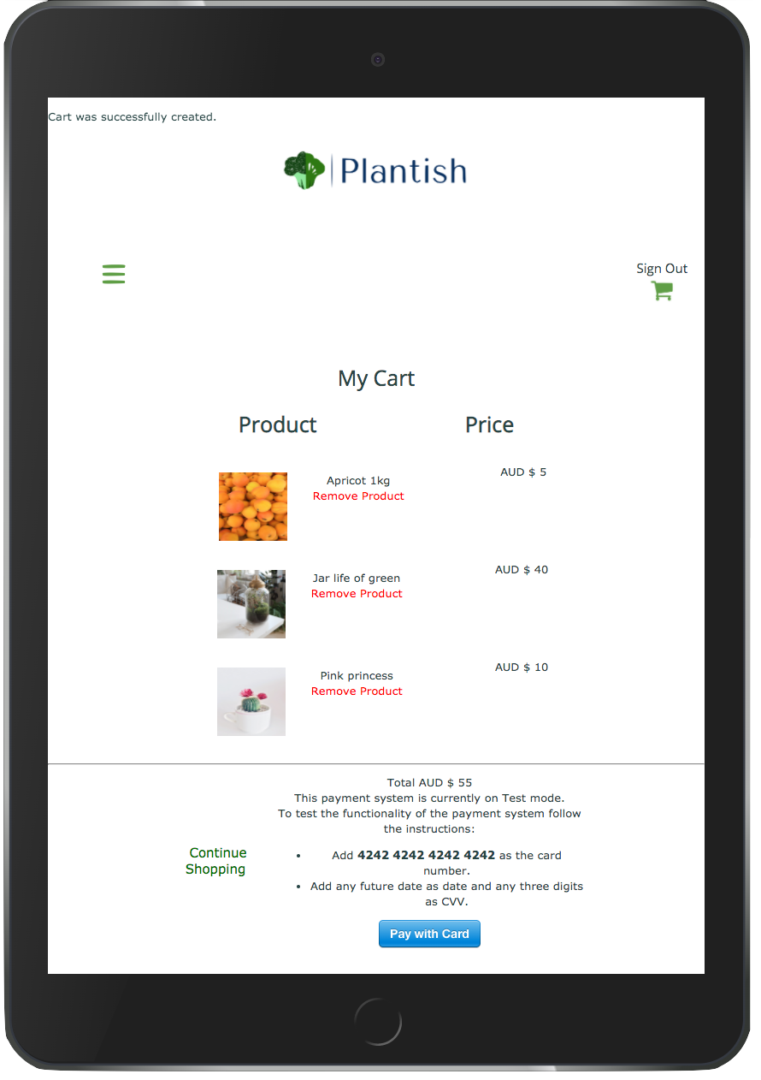
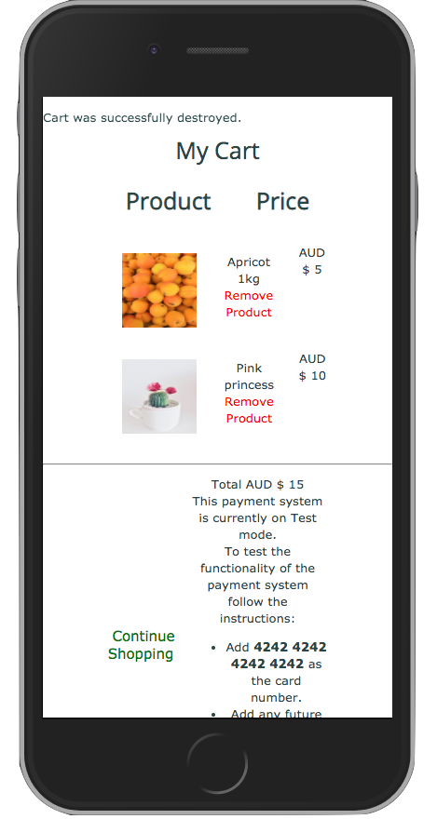
Screenshots
My Cart

Slide 36
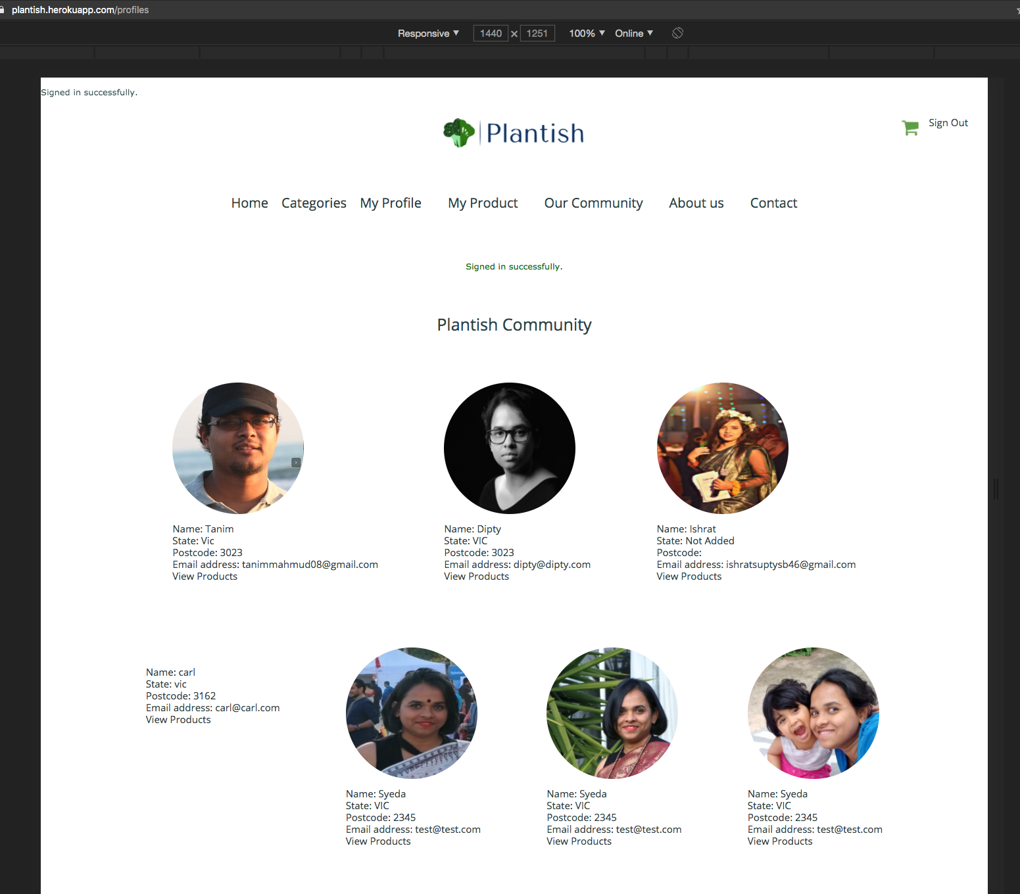

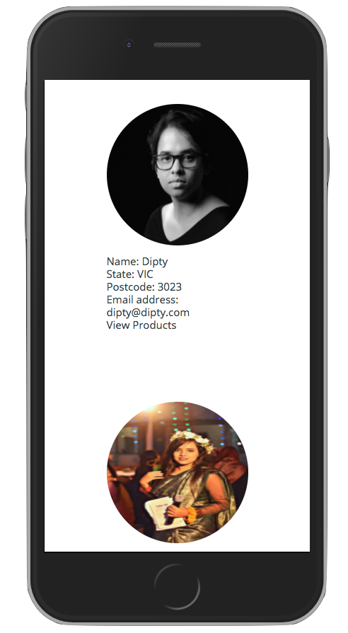
Screenshots
Community

Slide 37
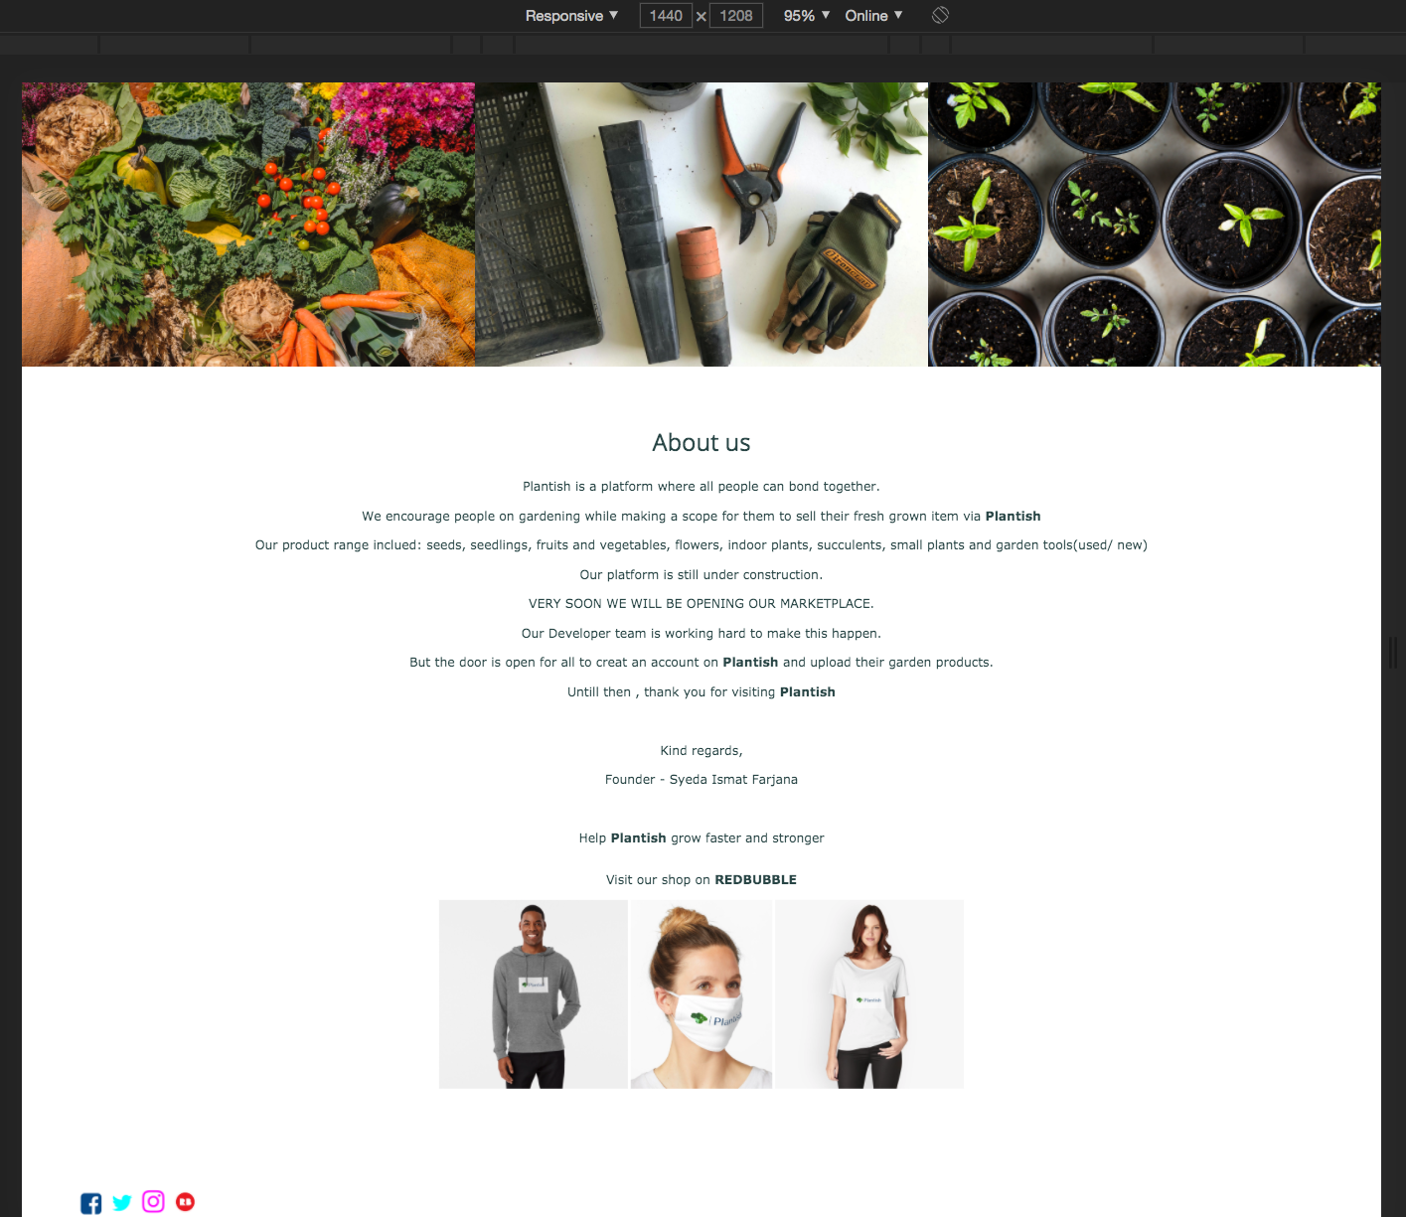
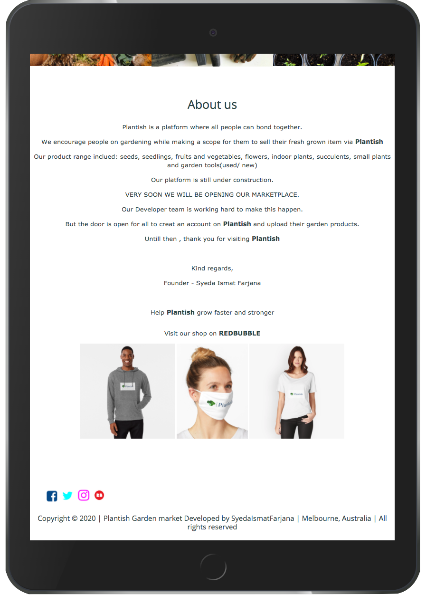
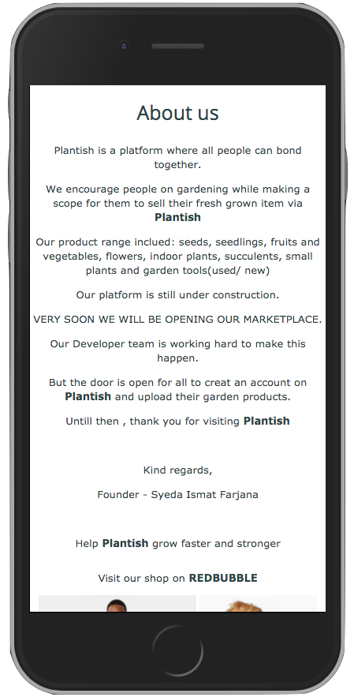
Screenshots
About us

Slide 38

Explanation of some Magic

Slide 39
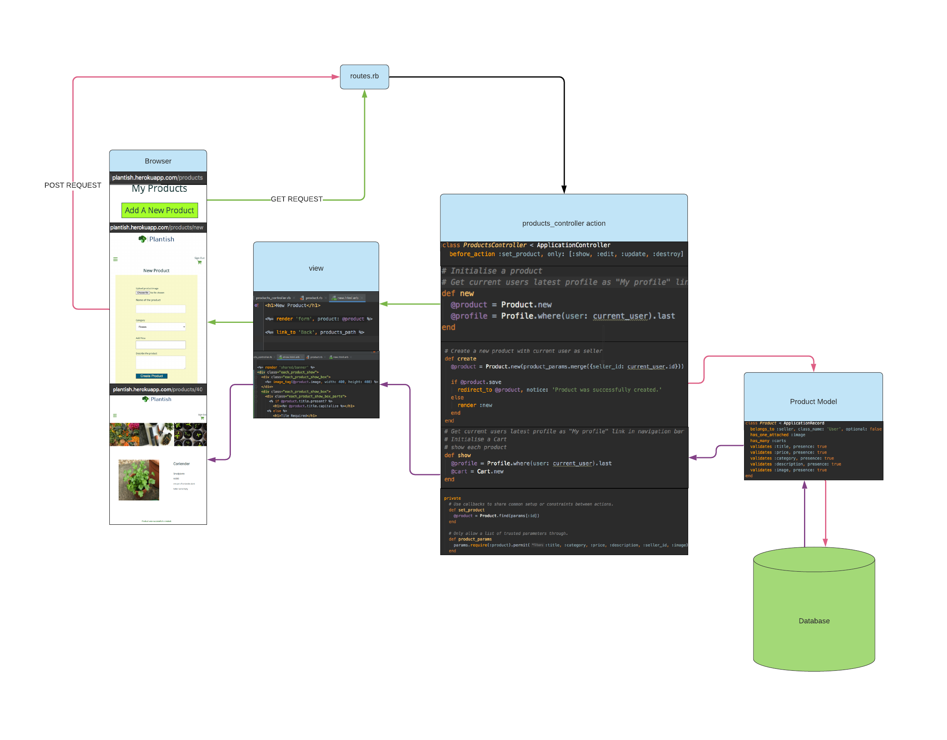
MVC
Adding a new product

Slide 40
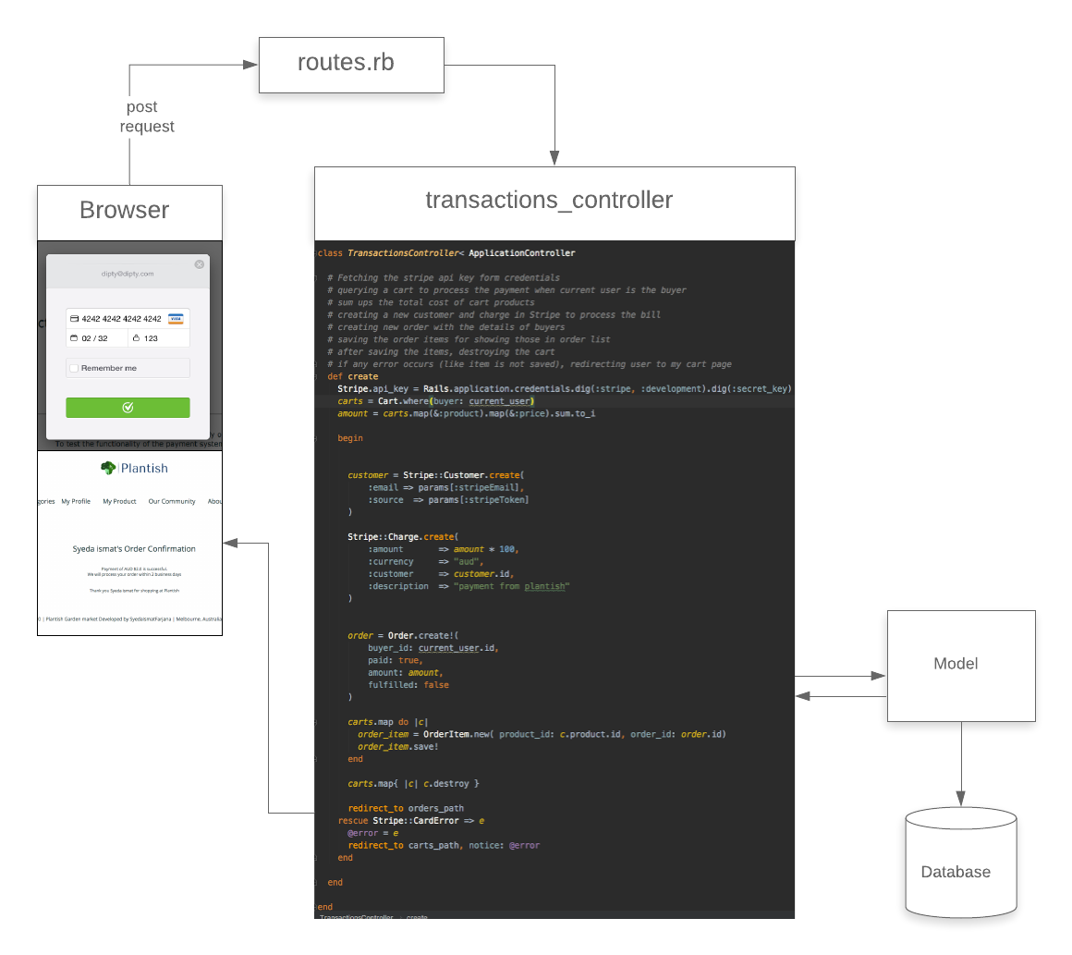
Optional Feature:Stripe Transaction

Slide 41
The Tech stack
Frontend
HTML
CSS
ERB
Backend
Ruby 2.6.3
Ruby on Rails 6
Tools
Rubymine
Git
Github
Lucid chart
Trello
DBDESIGNER
Balsamiq

Slide 42





The Tech stack( ..continued)
Utilities
AWS S3
Stripe
Devise
Database - Postgresql
Test - RSpec(unit test)

Slide 43
Deployment
The website is deployed on
Heroku

Slide 44
High-level Components
User
Profile
Plantish community
Products of Different Categories
Cart
Payment

Slide 45

Third Party Services
Heroku - for deployment
AWS S3 - uploading pictures
Stripe - Payment

Slide 46
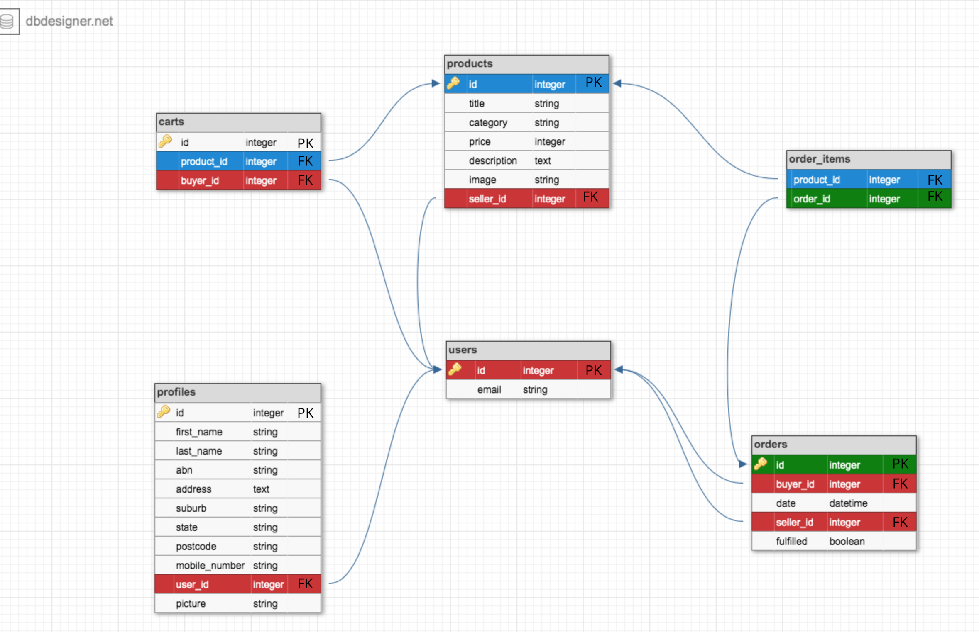
Entity Relationship Diagram

Slide 47






Active Record Model Relationships

Slide 48






Database Relations Implementation

Slide 49






Database Schema Design

Slide 50





Task Allocation and Tracking

Slide 51


Query Implementation with comments

Slide 52



Sanitise and validates input

Slide 53

RSpec Unit test

Slide 54

Manual testing and bug fixing

Slide 55
Future Improvement
Add admin part
Add Order management and payment distribution part for seller

Slide 56

Thank You

